Slide 1
Holographic Duals of Extremal Black Holes
9 March 2010 @ Chung Yuan Christian University
Chiang-Mei Chen
Department of Physics, National Central University

Slide 2
Outline
Black Hole: introduction
Holographic Principle
Kerr/CFT Correspondence (Warped AdS3/CFT2)
RN/CFT Correspondence (AdS2/CFT1)
Summary

Slide 3


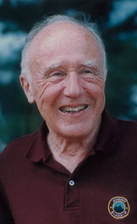
Black Hole
Gravitational force: universal and attractive
Black hole from Newtonian Mechanics:
Michell 1783, Laplace 1796
  Energy conservation (point masses)
  Escape velocity: (E = 0)
Black hole: (named by J. Wheeler, 1967)
nothing (including light) can escape from it.

Slide 4


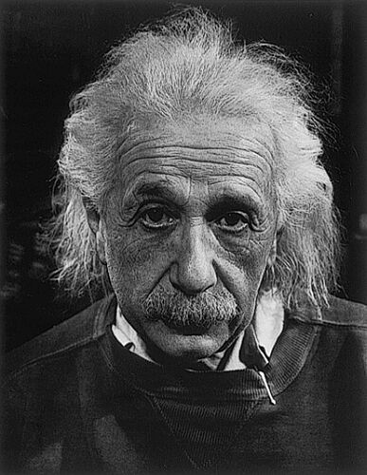
Black Hole
Event horizon: escape velocity equals to speed of light
  (Schwarzschild) radius of black hole (event horizon)
The general relativity gives the same result!
  Schwarzschild solution (1915)
Ya!!
I become a Black Hole

Slide 5
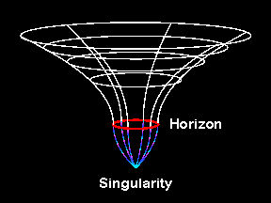


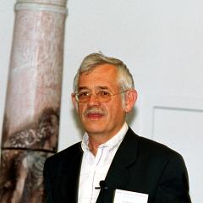
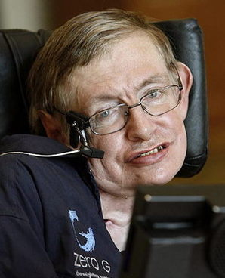

Black Hole
Area increasing law: S. Hawking
Black Hole Thermodynamics:
J. Bekenstein 1973, S. Hawking 1974
  Entropy
  Hawking temperature

Slide 6

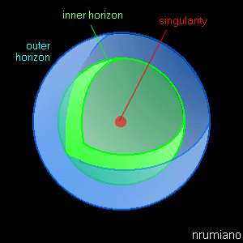
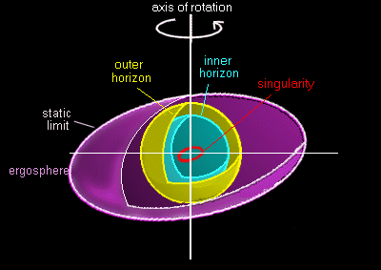
Black Hole
No Hair Theorem:
  Black holes have no hair and are simple objects.
  A black hole is completely characterized by three physical parameters: mass, charge and angular momentum.
Black holes in general can have more than one horizon:
  Extremal: inner and outer horizons are degenerated.

Slide 7

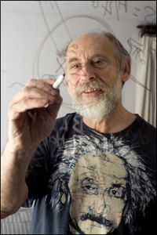
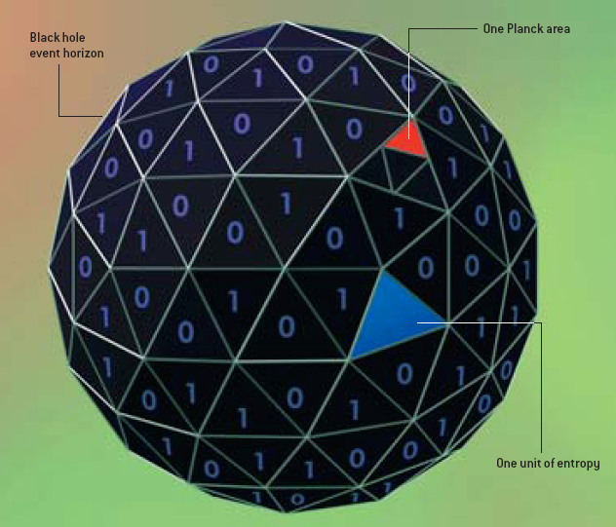
Holographic Principle
Holographic Principle: G. t’ Hooft 1993, L. Susskind 1994
Gravity
in bulk (D dim.)
Field Theory
on boundary (D-1 dim.)
Strong/Weak duality
Quantum Gravity

Slide 8

Holographic Principle
Holographic Principle seems strange and counterintuitive:
Could all of the information contained in your body actually be represented by your `shadow'?
The World is a Hologram?
Man ponders shadow,
or shadow ponders itself?

Slide 9

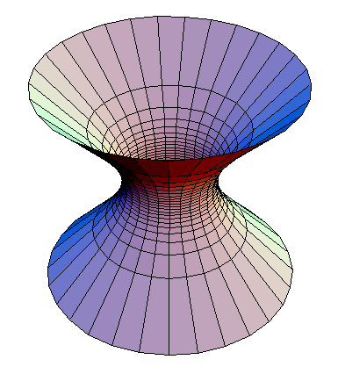
Holographic Principle
A preliminary hint: symmetry
Black Hole: anti de Sitter (AdS) space appears in the near horizon geometry of extremal black holes
Symmetry group of AdSn+1: SO(n, 2)
Conformal field theory (CFT):
Symmetry group of CFTn: SO(n, 2)
First Step:
Is there a holographic dual CFT for extremal black hole?

Slide 10
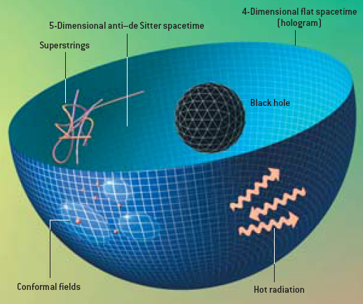
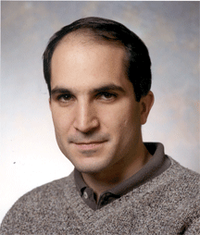
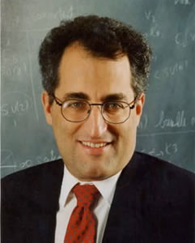
Holographic Principle
AdS/CFT Correspondence:
J. Maldacena 1997
IIB superstring theory
on AdS₅ × S⁵
N=4 SYM Theory
“Real conceptual change in our thinking about gravity.”
E. Witten, Science 285 (1999) 512
String Theory

Slide 11
Holographic Principle
CFT dual of (near) extremal black holes:
  Theoretical study of holographic principle (more insights to the foundation of quantum gravity).
Gravity dual to CFT:
  At the critical points, notable rescaling symmetries emerge, e.g. in condensed matter, superconductor etc.
  The AdS/CFT correspondence provides an approach which is possible to deal with strong coupled phenomena.
Entropic force:
  Gravity is an emergence of entropic force.

Slide 12
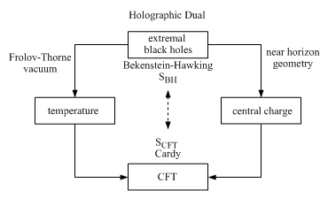
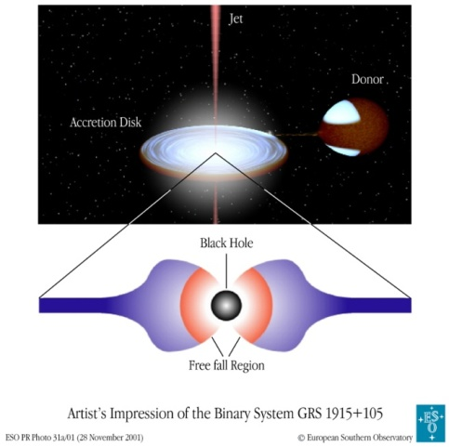
Kerr/CFT Correspondence
Guica, Hartman, Song, Strominger: arXiv:0809.4266
Kerr black hole: rotating (stationary) black hole characterized by mass M and angular momentum J.
Kerr/CFT schema
GRS 1915+105

Slide 13



Kerr/CFT Correspondence
Near Horizon geometry of Extremal Kerr (NHEK):
NHEK is a warped AdS3 ( Λ = 1 recovers AdS3 )
Isometry:
AdS3
Warped AdS3

Slide 14
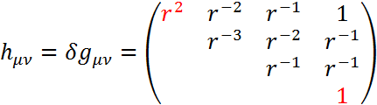
Kerr/CFT Correspondence
Asymptotic Symmetry Group (ASG): Boundary Condition
NHEK is not asymptotical flat, so there are no priori obvious boundary conditions.
Different boundary condition may reveal different physical context.
  Strong BC rules out all interesting excitations.
  Weak BC generates ill-defined results.
Appropriate BC
(admitting Virasoro generators)

Slide 15




Kerr/CFT Correspondence
Diffeomorphism generators:
Mode expansion:
Commutation relation:
Conserved charge:

Slide 16







Kerr/CFT Correspondence
algebra(ASG) Dirac brackets of charges
  NHEK:
Quantization:
Virasoro generators:
Virasoro algebra:
  central charge:
free parameter

Slide 17




Kerr/CFT Correspondence
Enhanced symmetry:
Temperature:
  There are no everywhere time-like Killing vector in NHEK, therefore no desired vacuum.
  Frolov-Thorne vacuum: time-like Killing vector in the region from horizon to the speed of light surface.
Eigen-mode expansion of a quantum field:
Left and right moving modes:

Slide 18





Kerr/CFT Correspondence
Boltzmann factor:
Temperatures of left- and right-moving modes :
  extremal limit:
  For extremal limit T_{H} = 0, but the quantum field outside horizon are not in pure state.
Entropy: Cardy formula (2D CFT entropy for large h)

Slide 19


Kerr/CFT Correspondence
Left moving part of CFT:
There is AdS2/CFT1 description for extremal Kerr black hole by considering the corresponding 2D effective action.
Castro, Larsen: arXiv:0908.1121
Properties:
  CFT temperature is a constant.
  h = c/24
  Central charge: (off-diagonal component in metric)

Slide 20


RN/CFT Correspondence
CFT dual of extremal RN black hole:
Warped AdS3/CFT2 description
  The U(1) bundle of warped AdS3 was recovered from the gauge field potential by uplifting the RN black hole into 5D gravity.
Hartman, Murata, Nishioka, Strominger: arXiv:0811.4393
Garousi, Ghodsi: arXiv:0902.4387
  The temperature of the dual CFT is charge dependent;
  The electric-magnetic duality is broken in the CFT side.

Slide 21







RN/CFT Correspondence
AdS2/CFT1 description
Chen, Sun, Zou: arXiv:0910.2076
Near Horizon geometry of Extremal RN (NHERN):
  Isometry: AdS₂ × S²
  Entropy:
Naïve (reasonable) expectation:

Slide 22




RN/CFT Correspondence
4D action:
  Ansatz:
2D effective action:
  consistent solution of constant scalar:
  General solution: a free function of time
f = 0 for extremal RN

Slide 23







RN/CFT Correspondence
Boundary counterterms: ensure well-defined EOM
Boundary stress tensor and current:
Asymptotic boundary condition:
  allowed transformations:

Slide 24




RN/CFT Correspondence
Gauge transformation:
Variation of stress tensor: (imposing f = 0)
Central charge: (right moving sector)
Castro, Grumiller, Larsen, McNees: arXiv:0809.4264
  suitable choice of L:

Slide 25



RN/CFT Correspondence
Central charge for dyonic black hole:
Discrepancy with previous result:
  uplifting
AdS₂ × S²
Radius of extra circle: 1 ➔ AdS radius

Slide 26

Summary
Extremal rotating black holes: warped AdS3/CFT2
  consistent boundary conditions exist
  asymptotic symmetry generators ➔ Virasoro algebra (CFT)
  Left moving central charge:
  Frolov-Thorne vacuum ➔ temperature of CFT
  S_{CFT} = S_{BH}
The results do not depend on the details of quantum gravity.
It can not address more information about the dual CFT in addition to the central charge.

Slide 27




Summary
RN/CFT Correspondence
right-moving
central charge
near-extremal
Uplifted RN could provide a gravitational solution for studying AdS2/CFT1 from AdS3/CFT2.

Slide 28


Summary
The other description: AdS2/CFT1
  boundary fields in 2D effective action
  variation of stress tensor ➔ central charge
Two descriptions indicate that CFT1 may can be treated as a chiral part of CFT2.
CFT dual of near extremal RN black hole (in progress)
left moving sector
right moving sector

