Slide 1
Investigation of 3-body hadronic B decays at Belle
Min-Zu Wang National Taiwan University
on behalf of the Belle Collaboration
Outline
Introduction
B⁰→ D_{s}⁻K⁰_{S}π⁺, B⁺→ D_{s}⁻K⁺K⁺
B⁰→ X(3872)K⁺π⁻
B⁰→ D^{*+}π⁻ω
B⁰→ pΛD⁻, pΛD*⁻
Summary
@CYCU

Slide 2

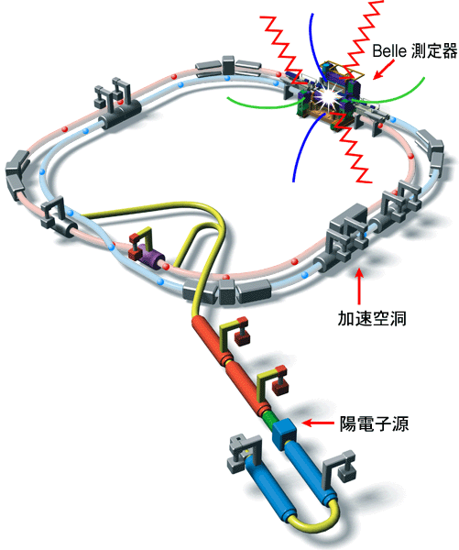
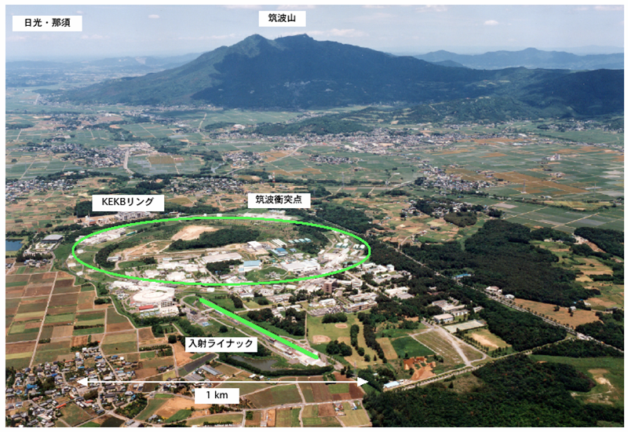
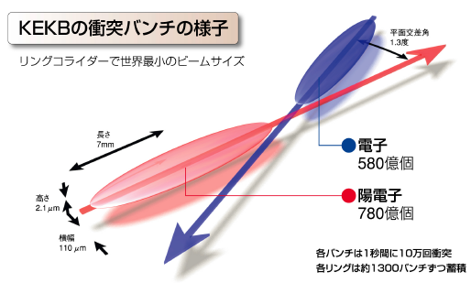
The KEKB-factory
World record of instant luminosity
21.083 x 10³³ cm⁻² s⁻¹

Slide 3
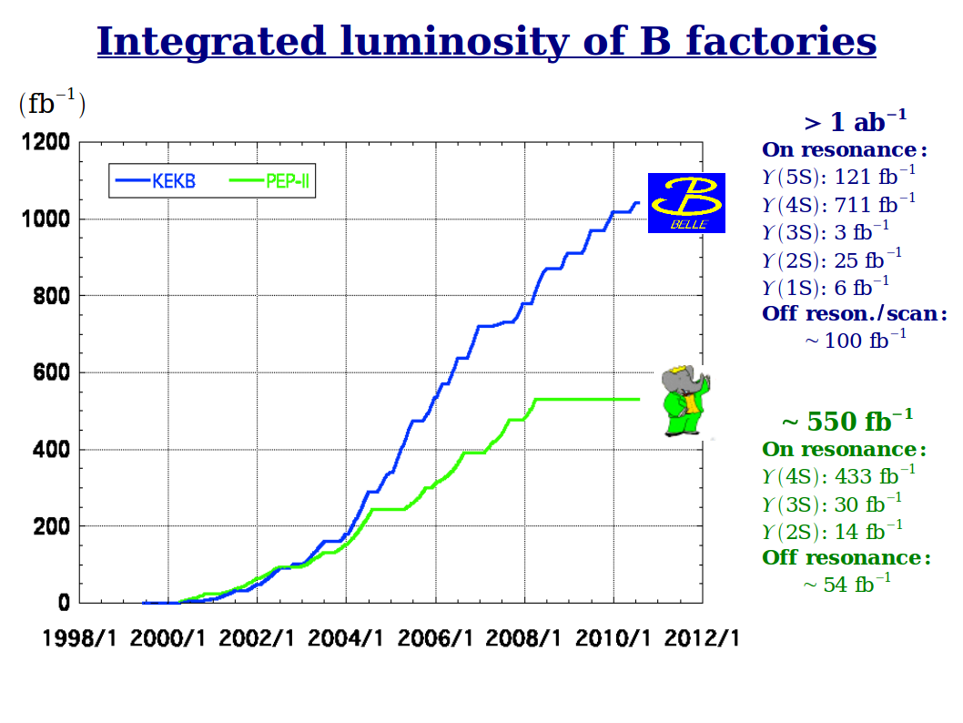
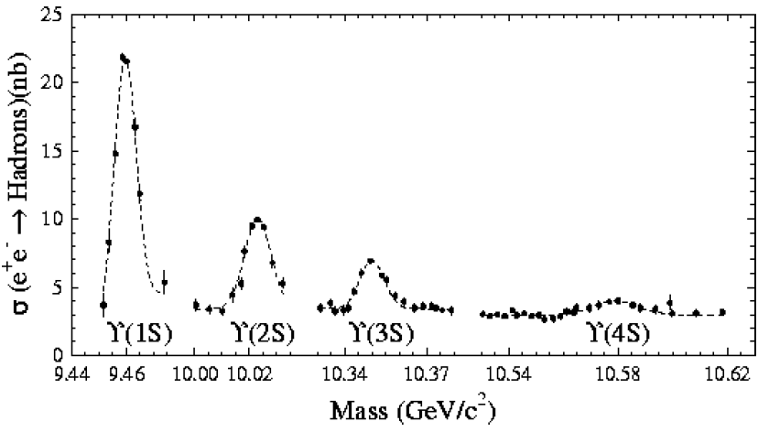
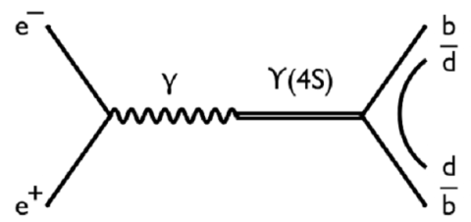
Full data Set
~772M BBpairs

Slide 4
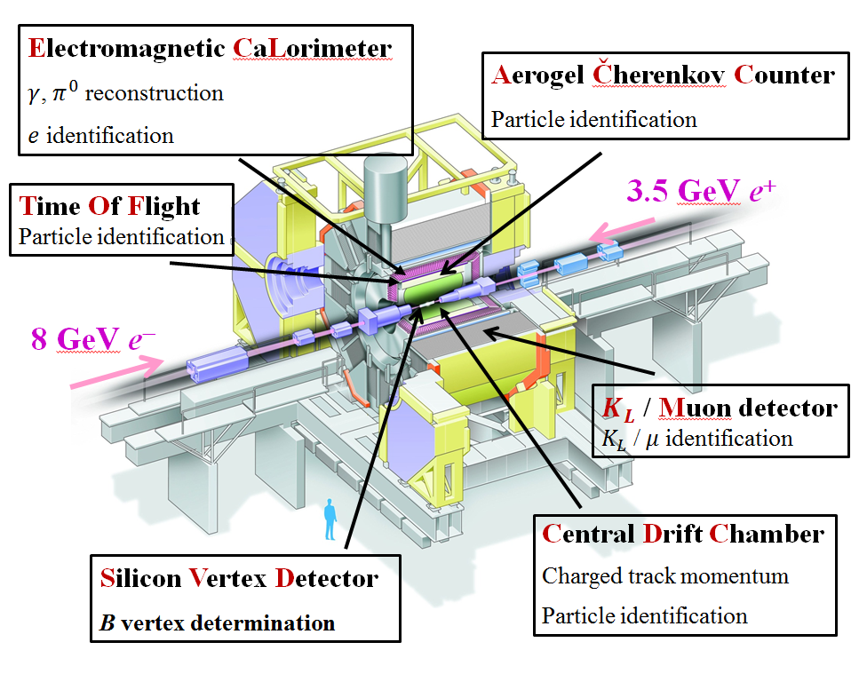
Belle Detector

Slide 5
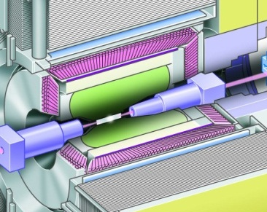
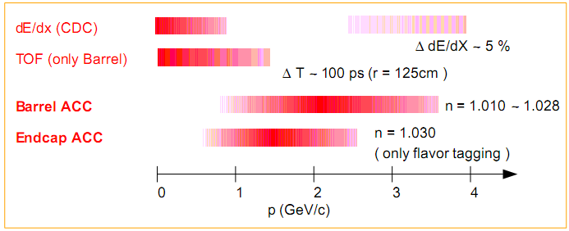

Particle Identification
Particle Identification:
Aerogel Cerenkov Counter: Silica aerogel
Time of Flight: Plastic scintillator
Central Drift Chamber (dE/dx): Small cell + He/C₂H₆
Cerenkov light detected by FM-PMT
Timing resolution～100ps
Momentum Measurement (CDC)
1. P_{X-Y}: Curvatures in the transverse plane
2. P_{Z} : Helical track information
dE/dx Information
ACC
TOF
CDC

Slide 6
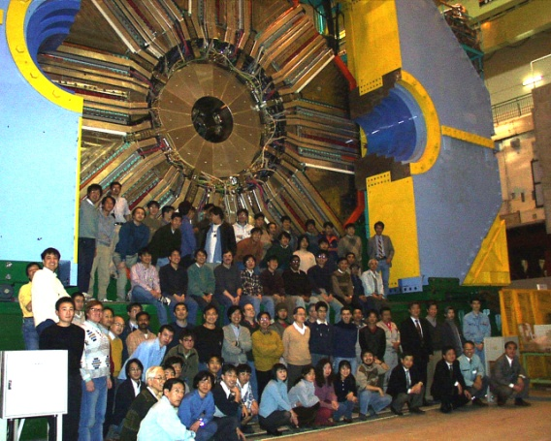
International Collaboration: Belle
Aomori U.
BINP
Chiba U.
Chonnam Nat’l U.
U. of Cincinnati
Ewha Womans U.
Frankfurt U.
Gyeongsang Nat’l U.
U. of Hawaii
Hiroshima Tech.
IHEP, Beijing
IHEP, Moscow
IHEP, Vienna
ITEP
Kanagawa U.
KEK
Korea U.
Krakow Inst. of Nucl. Phys.
Kyoto U.
Kyungpook Nat’l U.
EPF Lausanne
Jozef Stefan Inst. / U. of Ljubljana / U. of Maribor
U. of Melbourne
Nagoya U.
Nara Women’s U.
Fu-Jen U.
National Central U..
National Taiwan U.
National United U.
Nihon Dental College
Niigata U.
Osaka U.
Osaka City U.
Panjab U.
Peking U.
U. of Pittsburgh
Princeton U.
Riken
Saga U.
USTC
Seoul National U.
Shinshu U.
Sungkyunkwan U.
U. of Sydney
Tata Institute
Toho U.
Tohoku U.
Tohuku Gakuin U.
U. of Tokyo
Tokyo Inst. of Tech.
Tokyo Metropolitan U.
Tokyo U. of Agri. and Tech.
Toyama Nat’l College
U. of Tsukuba
Utkal U.
VPI
Yonsei U.
Still growing!
18 countries, ~ 85 institutes, ~500 collaborators

Slide 7
Why 3-body hadronic B decays?
Three-body B decays offer a good studying ground for the structures of the intermediate states e.g. angular analysis, Dalitz analysis
Check the interplay between the short distance weak interaction and the long distance strong interaction e.g. factorization picture
Information from similar decays can constrain the CKM matrix elements e.g. V_{us}/V_{ud}
Find unexpected exotic states e.g. pentaquark
7

Slide 8
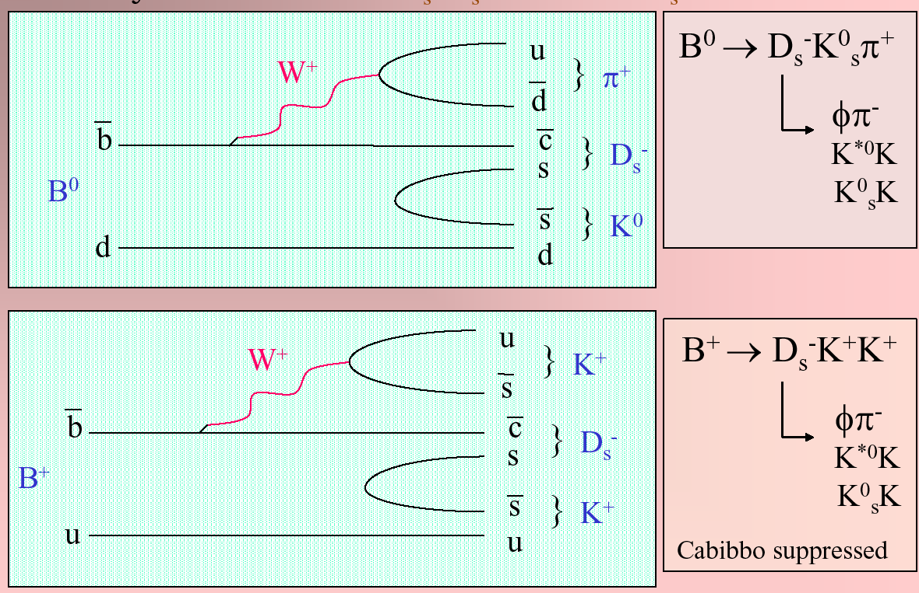



B⁰→ D_{s}⁻K⁰_{S}π⁺, B⁺→ D_{s}⁻K⁺K⁺
All charged final state particles
Apply charmonium veto and B⁰→ D_{s}⁻ D ⁺ (→ K⁰_{S}π⁺) veto
8

Slide 9
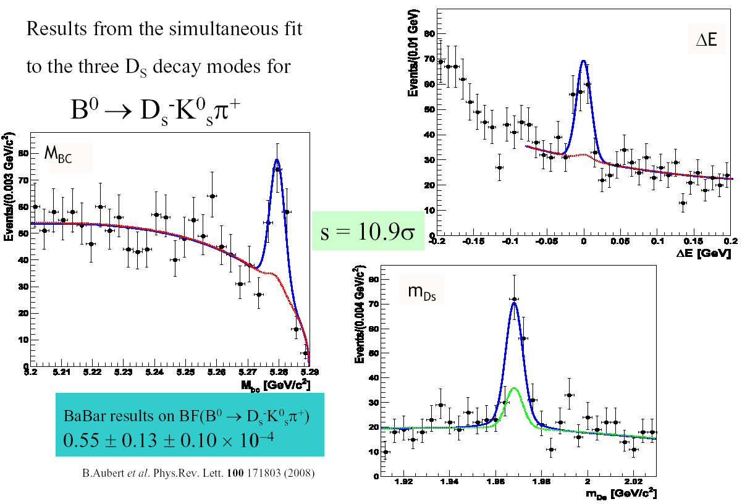
B⁰→ D_{s}⁻K⁰_{S}π⁺ results
Phys.Rev.D91, 032008
657M BB pairs
BABAR result
PRL100, 171803
[5.5±1.3±1.0]X10⁻⁵
[4.7 ± 0.6(stat)± 0.5(syst)] X 10⁻⁵
9

Slide 10
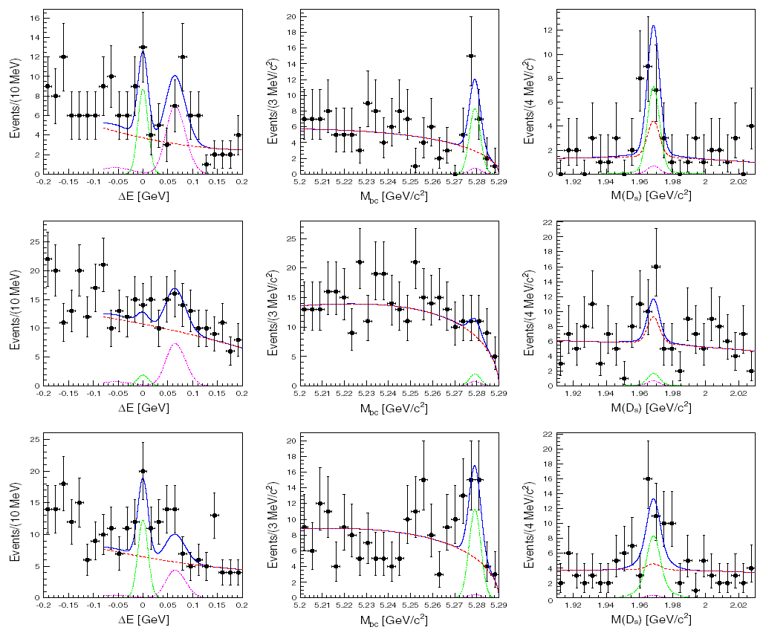



B⁺→ D_{s}⁻K⁺K⁺ results
D*_{s}
BABAR result
[1.1±0.4±0.2]X10⁻⁵
[0.93 ± 0.22(stat)± 0.10(syst)] X 10⁻⁵
10

Slide 11
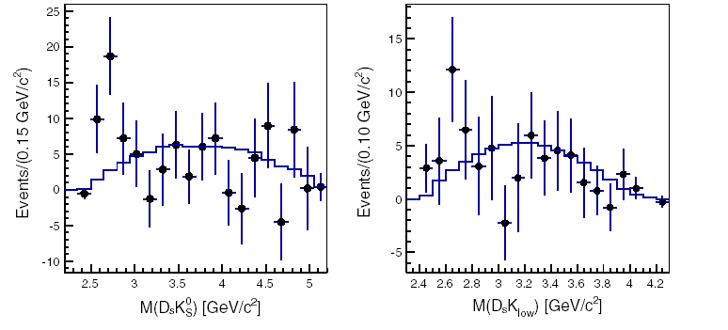
Intermediate structure
Similar pattern found in B⁺→ D_{s}⁻K⁺π⁺ and B⁰→ D_{s}^{(*)-}K⁺l⁺ν
Need more statistics for an angular analysis or Dalitz analysis
Data points
Sideband background subtracted
histogram
phase space distribution
11

Slide 12
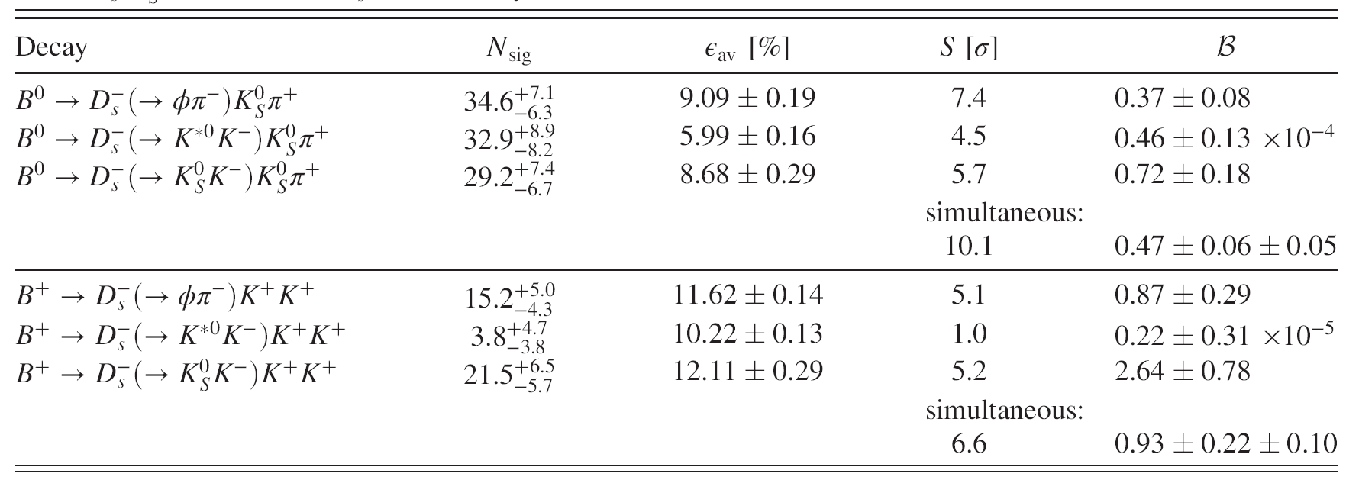
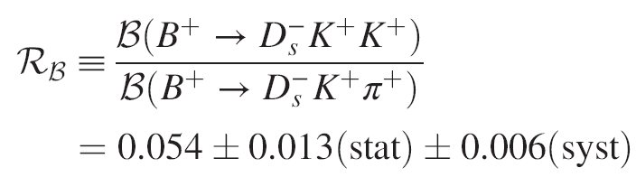
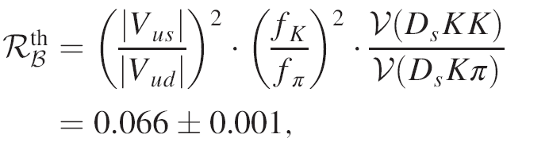
Compared with naïve factorization
Branching fraction measurements are consistent with and more precise than the BABAR results
Phys.Rev.D 80, 052005 (2009)
decay const.
phase space volume
12

Slide 13
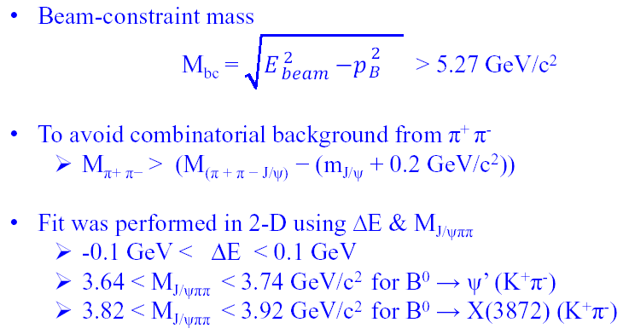
B⁰→ X(3872)K⁺π⁻
X(3872): mixture of D⁰D^{*0} and χ’_{c} (→ γ J/ ψ ) ?
Use X(3872) → J/ ψ π⁺π⁻for X reconstruction

Slide 14
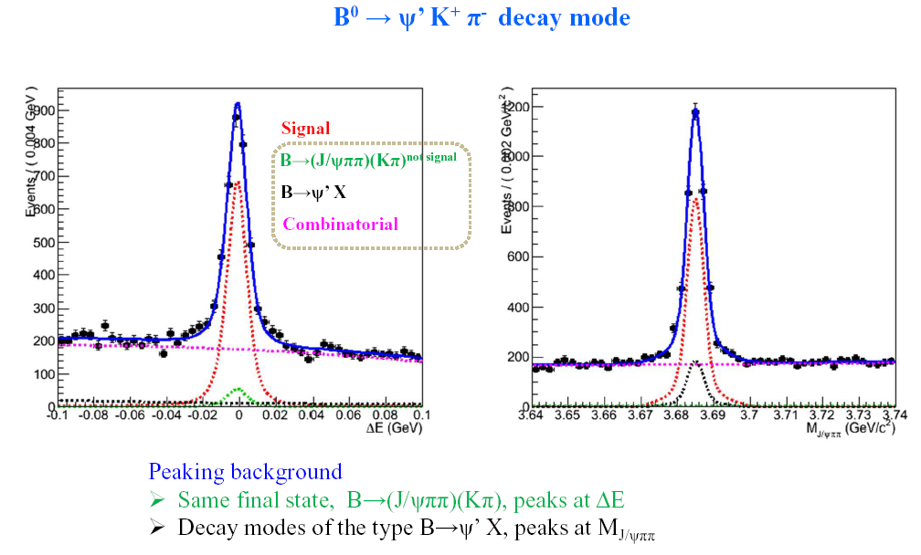
B⁰→ ψ’K⁺π⁻ control sample
same final state

Slide 15
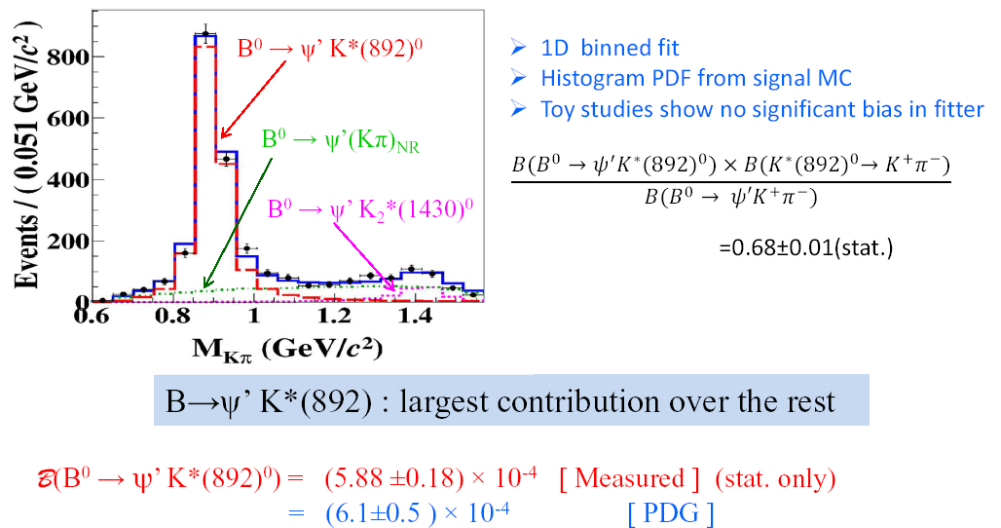
K⁺π⁻ specturm of control sample

Slide 16
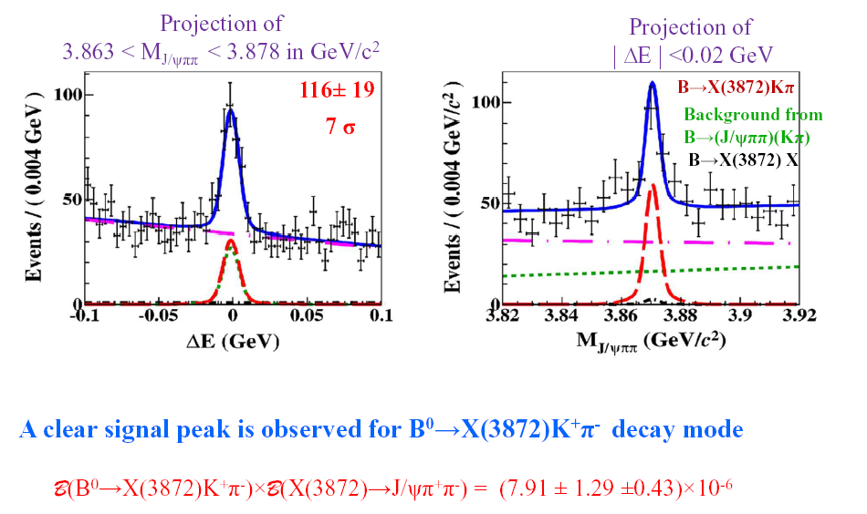
Results of B⁰→ X(3872)K⁺π⁻
Phys.Rev.D91, 051101

Slide 17
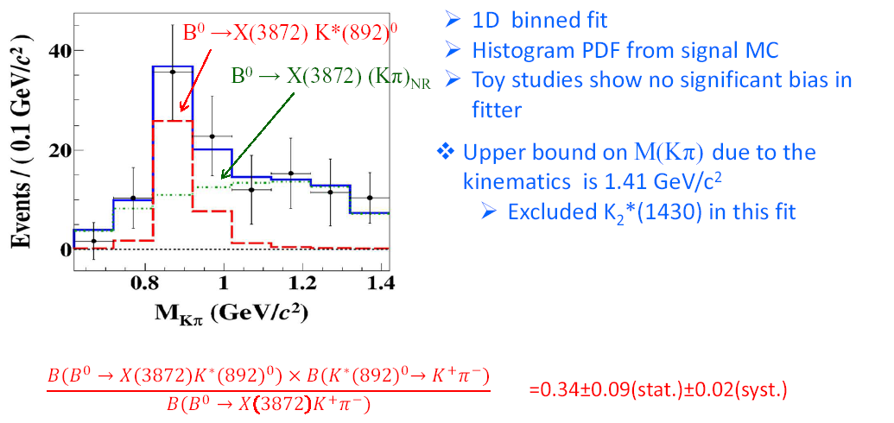
K⁺π⁻ specturm of B⁰→ X(3872)K⁺π⁻
different from ψ’!

Slide 18
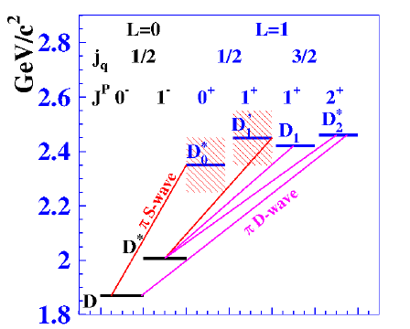
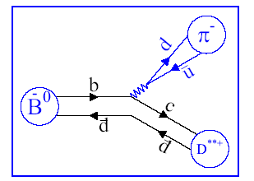
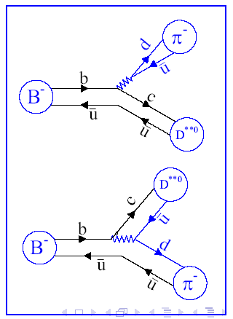
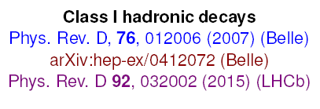
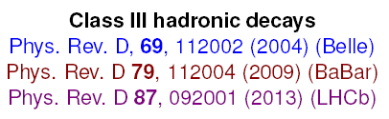
Introduction to D** and factorization picture

Slide 19
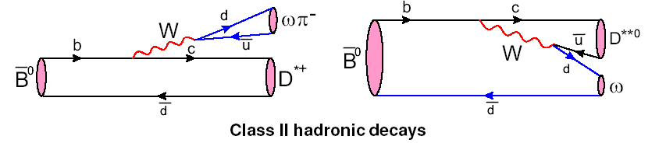


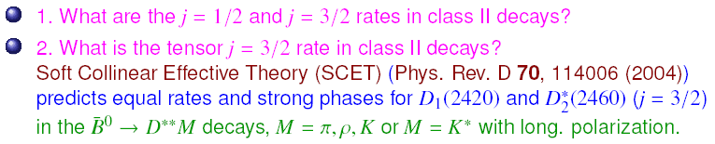
Motivation for B⁰→ D^{*+}π⁻ω

Slide 20
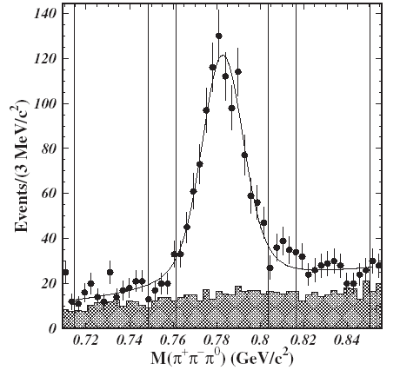
Analysis strategy
Use charged tracks only to reconstruct
Tight selection on reconstructed D⁰ mass and mass difference between D^{*+} and D⁰
Apply kinematic information to select purer ω
Tight cut on the M_{bc}
Form Dalitz plots from the
signal region and sideband
regions in the ΔE and M_{3π} plane
Use likelihood fit to extract signal amplitudes
D^{*+}→ D⁰ π⁺ (D⁰ → K⁻π⁺)

Slide 21
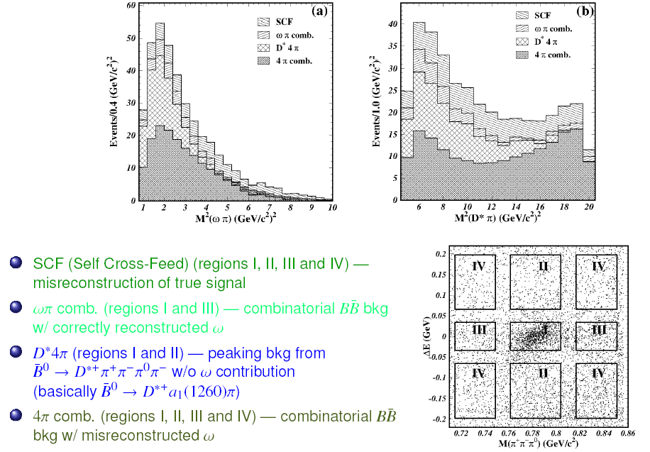
Background study on Dalitz plot
signal region I

Slide 22

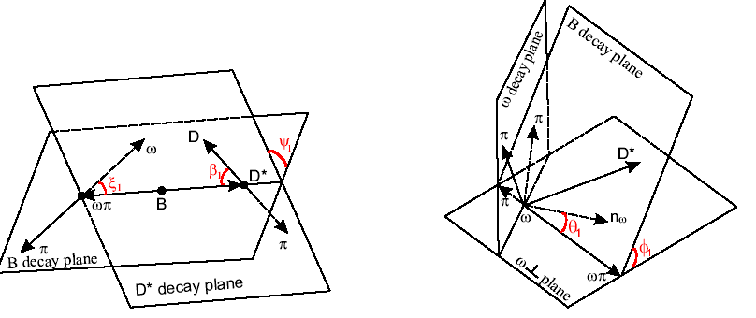
Complicated amplitudes with two kinds of sequential two-body decays
ωπ as an example

Slide 23
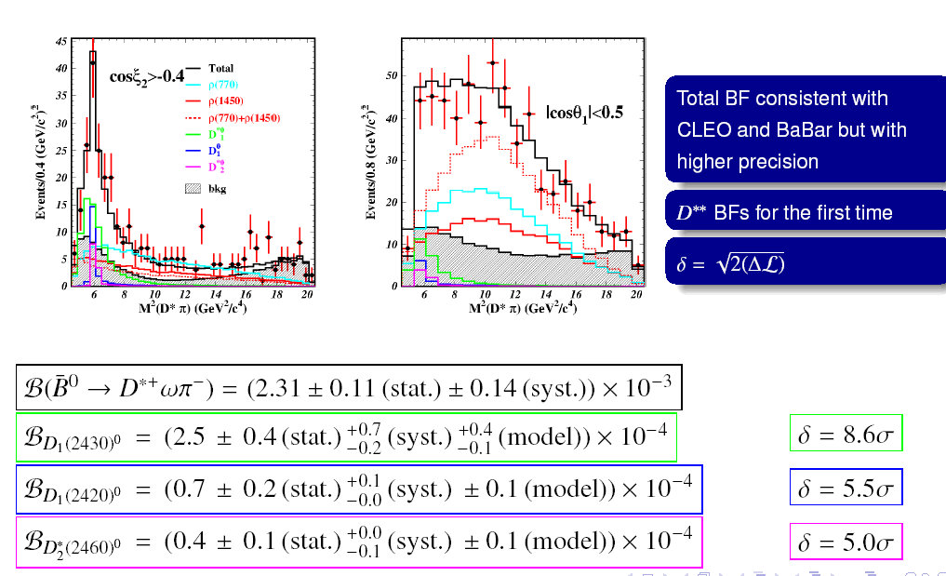
Results of B⁰→ D^{*+}π⁻ω
Phys.Rev.D92, 012013
D** enriched
D** depleted

Slide 24
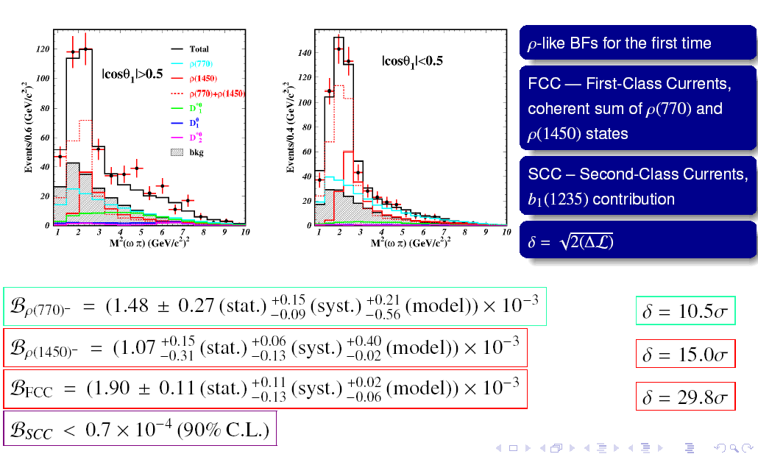
ω π⁻ spectrum
D** enriched
D** depleted

Slide 25
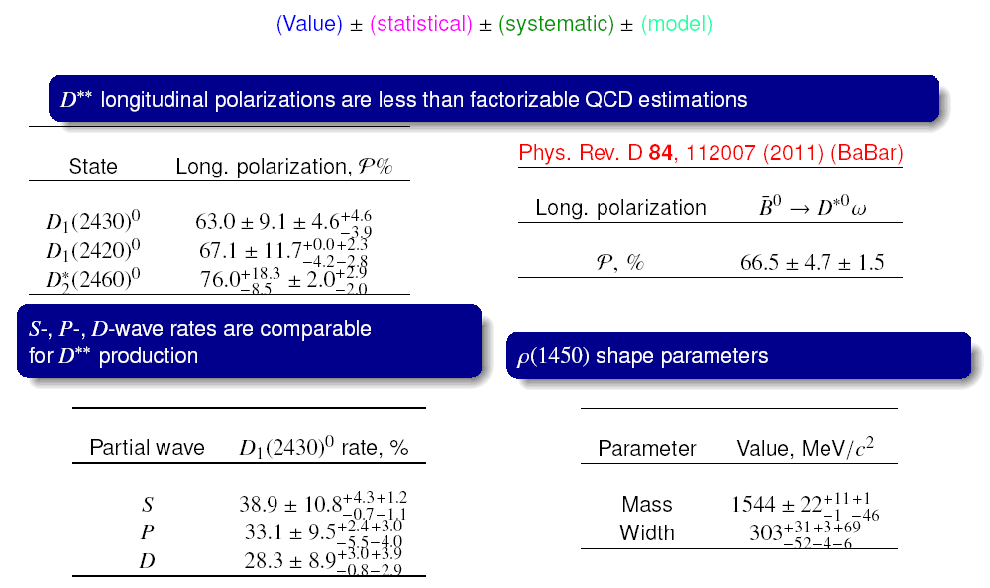
Results of angular analysis

Slide 26
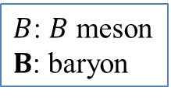
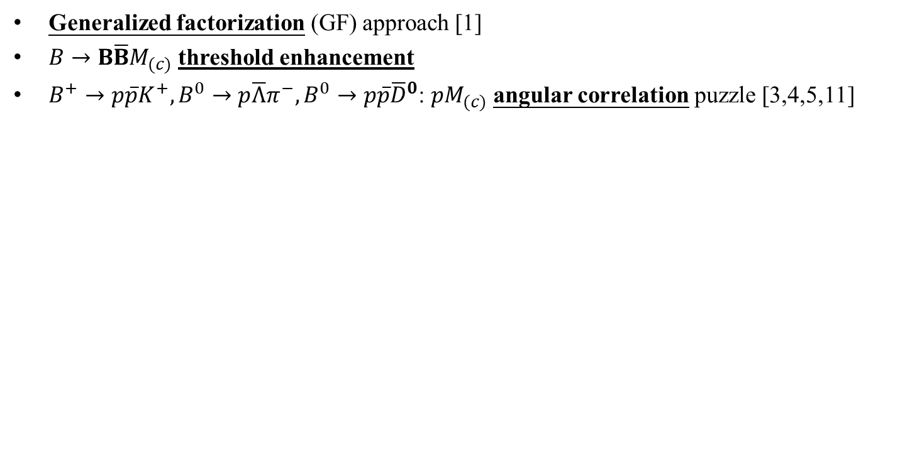
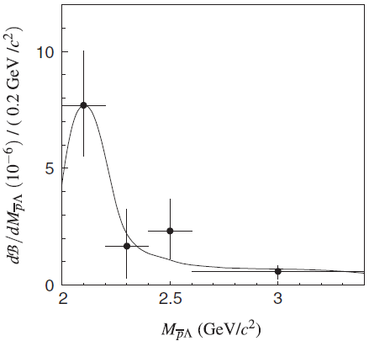
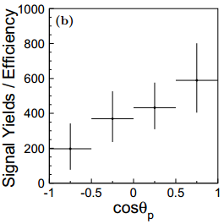
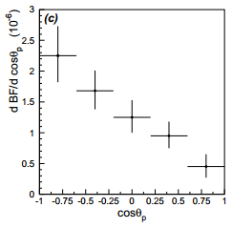



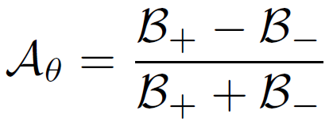
B⁰→ pΛD^{(*)-} physics motivation
angle between proton and meson
in the dibaryon rest frame
large forward backward asym. found
PRD74, 051101
26

Slide 27
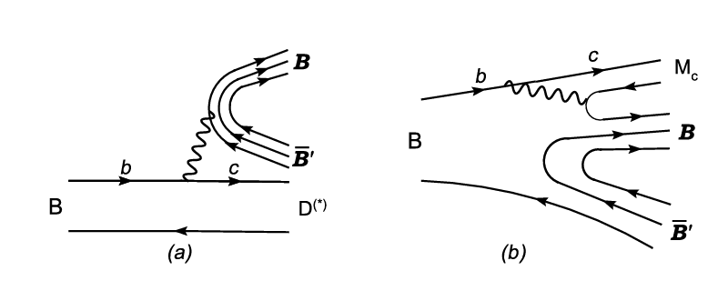
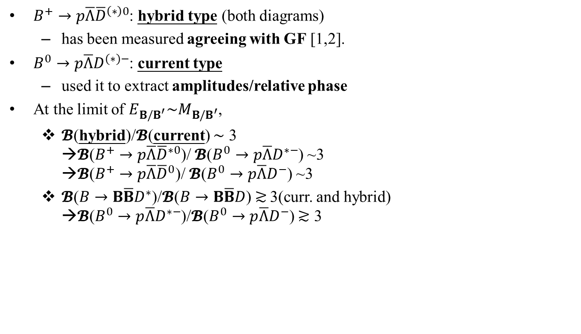
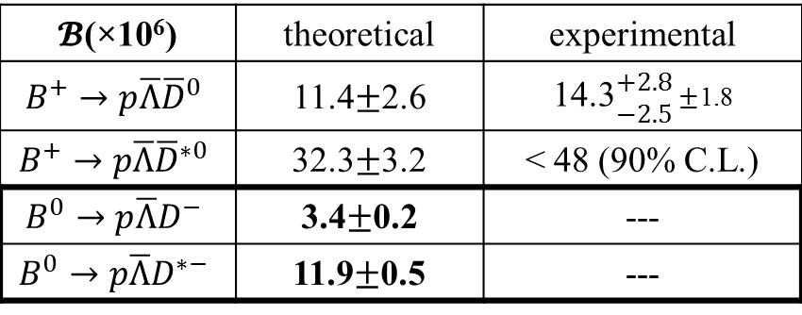
Theoretical predictions
C. Chen et. al. PRD78, 054016
with predictions
Transition type
 | theoretical | experimental
 |  | < 48 (90% C.L.)
 |  | ---
 |  | ---
Current type
27

Slide 28
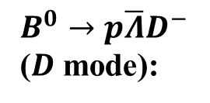
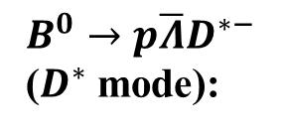



















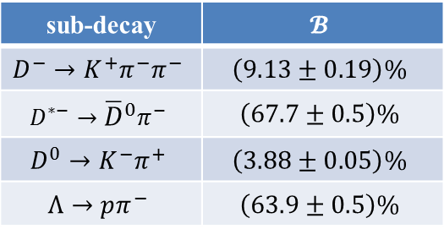
Signal decay chain
Decay process:
sub-decay | $$𝓑$$
$$D^{−}→K^{+}π^{−}π^{−}$$ | $$\left(9.13±0.19\right)\%$$
$$D^{∗−}→{\overline{D}}^{0}π^{−}$$ | $$\left(67.7±0.5\right)\%$$
$$D^{0}→K^{−}π^{+}$$ | $$\left(3.88±0.05\right)\%$$
$$Λ→pπ^{−}$$ | $$\left(63.9±0.5\right)\%$$
28

Slide 29
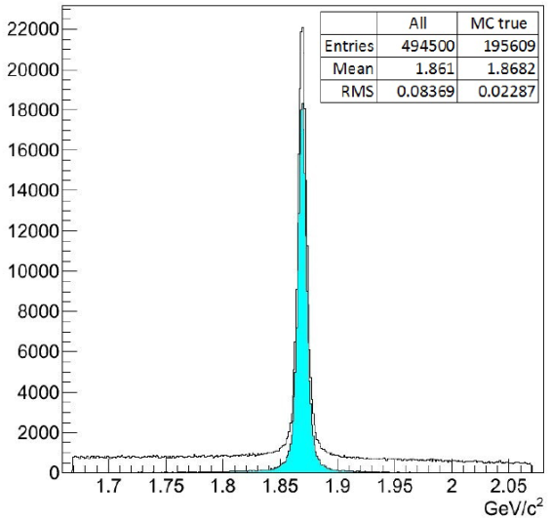
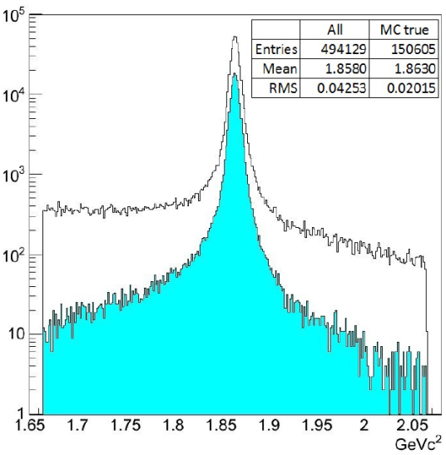
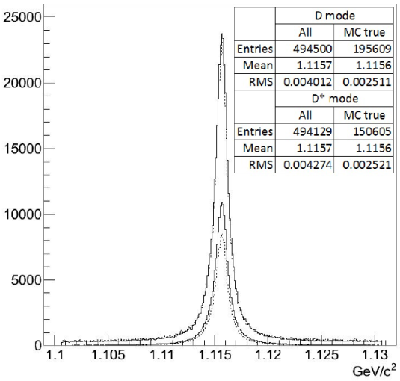








Data signal reconstruction
Mass window of reconstructed immediate states
Item
 | 1.102 – 1.13
 | 1.7 – 2.04
 | 1.72 – 2.02
 | 1.86 – 2.16
 | 0.136 – 0.156
29

Slide 30






Data signal extraction
772M BB pairs
We observe significant signal yield in data.
Larger than expectation from GF.
30

Slide 31




Threshold enhancement
arXiv:1509.03034
31

Slide 32




Angular distribution
32

Slide 33
Summary
The branching fraction measurements of B⁰→ D_{s}⁻K⁰_{S}π⁺ and B⁺→ D_{s}⁻K⁺K⁺ agree with BABAR results
Consistent with the naïve factorization picture using the nominal CKM matrix elements
First observation of B⁰→ X(3872)K⁺π⁻ with dominant contribution from non-resonant K⁺π⁻
First observations of B⁰→ D₁(2430)⁰ω, D₁(2420)⁰ω, and D₂*(2460)⁰ω with complicated angular analysis
The branching fraction measurements of B⁰→ pΛD^{(*)-} disagree with the GF predictions
Threshold enhancement is observed and maybe a hint for a sizable angular asymmetry in D* mode
33

