Slide 1
A proposal of a New Charged Lepton Flavor Violation Experoment: μ e e e in muonic atom
−
−
−
−
SATO, Joe (Saitama University)
M. Koike, Y. Kuno, J. S, M.Yamanaka, Phys. Rev. Lett. 105, 121601
Y. Uesaka, Y. Kuno, J. S, T. Sato, M.Yamanaka., arXiv:1602.XXXXX

Slide 2
Introduction

Slide 3
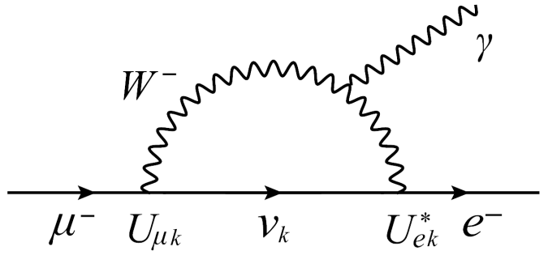
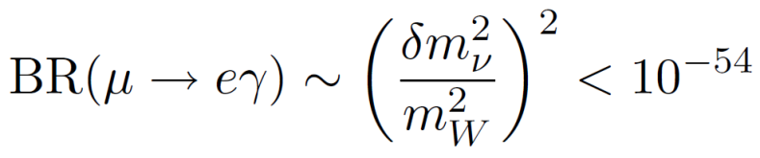
Introduction
Lepton Flavor is exact symmetry in SM
as long as neutrinos are massless
Charged Lepton Flavor Violation (cLFV) through Lepton Mixing
in the neutrino oscillation
But …
Invisible, eternally
Strong suppression of FCNC by GIM
Detection of the LFV signal
Clear evidence for beyond SM

Slide 4

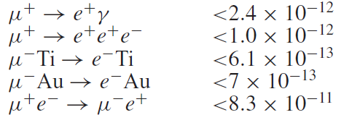
Introduction
cLFV from muon decay
Upper limit on Br
Annu. Ref. Nucl. Part. Sci. 2008. 58:315-41
W. J. Marciano, T.Mori, and J. M. Roney
Long history

Slide 5
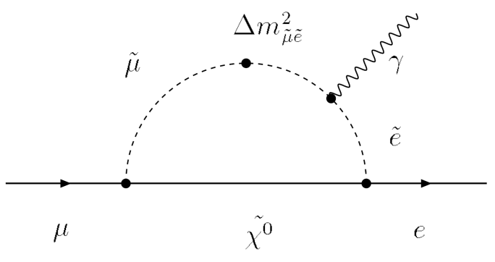
Introduction
Indeed, in physics beyond SM, Large FCNC is expected
Particularly Combining with neutrino oscillation
Large FCNC in charged lepton is expected
(must appear ??)
e.g. a supersymmetric model
Enhancement of LFV through the slepton mixing
Detectable at future experiments
Two or more flavors are needed to observe cLFV
Search for LFV with muon is inevitable

Slide 6
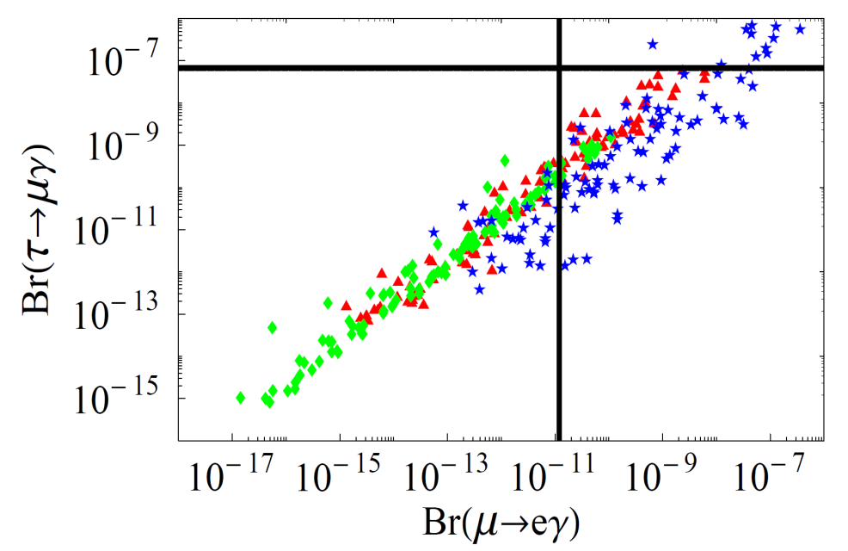
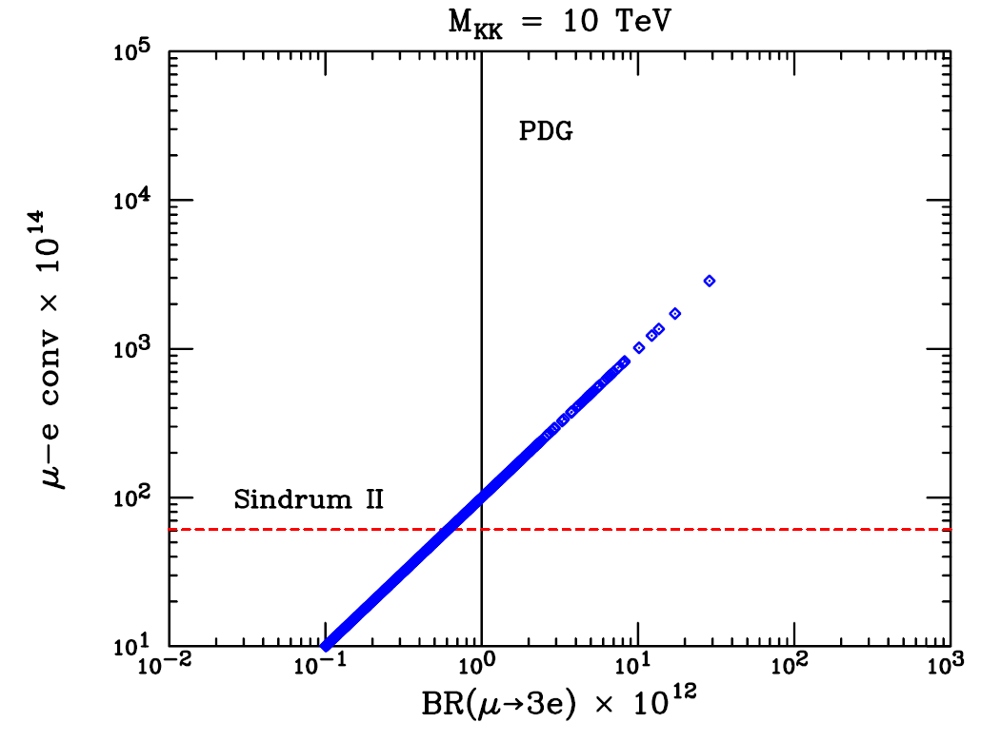
Introduction
Supersymmetric model
Extra dimension model
[M.~Raidal et al., Eur. Phys. J. C 57 (2008)]
[K.~Agashe, et al., Phys. Rev. D 74 (2006)]
Comparing LFV signals and their rates
Discrimination of new physics models
Prove for structure of new physics
Desire for many detectable cLFV processes

Slide 7
Introduction
cLFV from muon decay
Upper limit on Br
Annu. Ref. Nucl. Part. Sci. 2008. 58:315-41
W. J. Marciano, T.Mori, and J. M. Roney
Long history

Slide 8
Introduction
New idea for cLFV search
μ
e
e
e
－
－
－
－
in muonic atom
What is target ?
μ
Flavor violation between and e
What is advantage ?
Sensitive to both photonic dipole cLFV operator
and 4-Fermi contact cLFV operator
Clean signal [ back-to-back dielectron ]

Slide 9
Basic Idea
μ
e
e
e
－
－
－
－

Slide 10
μ
e
e
e
Muonic atom
electron 1S orbit
muon 1S orbit
nucleus
muon
electron

Slide 11
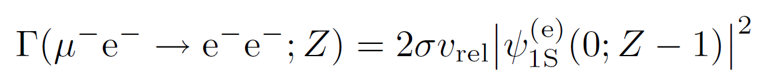
μ
e
e
e
LFV vertex
μ
e
－
－
e
－
e
－
in muonic atom
electron 1S orbit
muon 1S orbit
Interaction rate

Slide 12
μ
e
e
e
LFV vertex
μ
e
－
－
e
－
e
－
in muonic atom
electron 1S orbit
muon 1S orbit
Interaction rate
μ
e
Overlap of wave function of and

Slide 13
μ
e
e
e
Overlap of wave functions
Muonic atom
Approximation
∴
m << m
Muon localization at nucleus position
e
μ
Overlap = electron wave function at nucleus

Slide 14
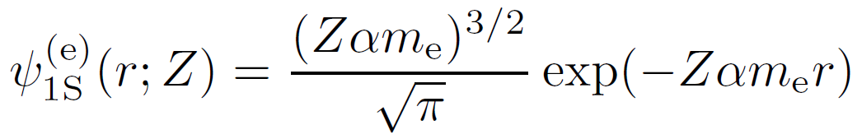
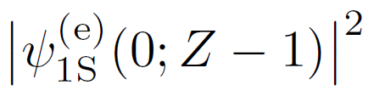
μ
e
e
e
Muonic atom
Electron wave function
r : radial coordinate (distance from nucleus)
Z : atomic number of nucleus in muonic atom
Overlap of wave functions

Slide 15
μ
e
e
e
LFV vertex
μ
e
－
－
e
－
e
－
in muonic atom
electron 1S orbit
muon 1S orbit
Interaction rate
Cross section for elemental interaction

Slide 16
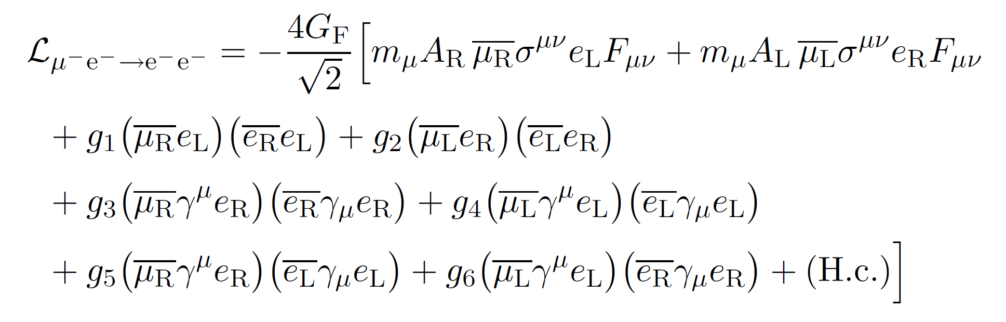








μ
e
e
e
Effective Lagrangian
[ Y. Kuno and Y. Okada Rev. Mod. Phys. 73 (2001) ]
cLFV effective coupling constant
Sensitive to the structure of new physics

Slide 17
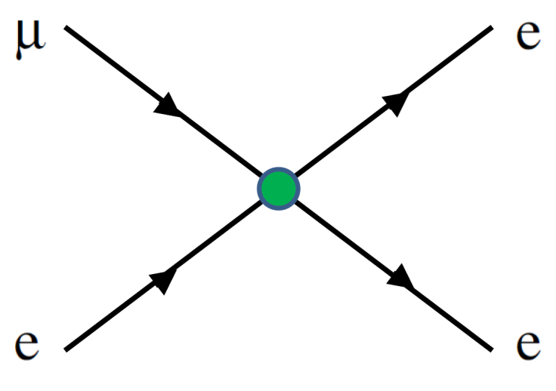
μ
e
e
e
Effective Lagrangian
[ Y. Kuno and Y. Okada Rev. Mod. Phys. 73 (2001) ]
4-Fermi interaction type

Slide 18
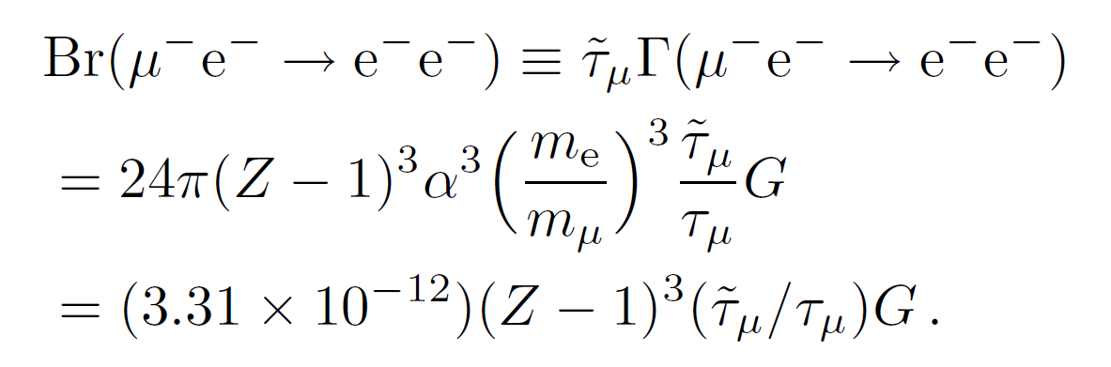
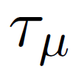
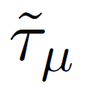
μ
e
e
e
4-Fermi interaction dominant case
Branching ratio
Lifetime of free muon (2.197 10 s)
×
-6
1
2.19 10 s for H
×
-6
Lifetime of bound muon
238
(7 - 8) 10 s for U
×
-8

Slide 19


μ
e
e
e
4-Fermi interaction dominant case
Branching ratio

Slide 20
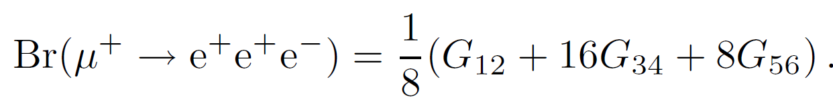
μ
e
e
e
4-Fermi interaction dominant case
Branching ratio
( )
μ
e
e
e
Comparison two BRs probe for CP violating

Slide 21
μ
e
e
e
4-Fermi interaction dominant case
Branching ratio
Enhancement factor from overlap of wave functions
Positive charge attracts muon and electron toward the nucleus position.
∴
Notable advantage for heavy nuclei

Slide 22
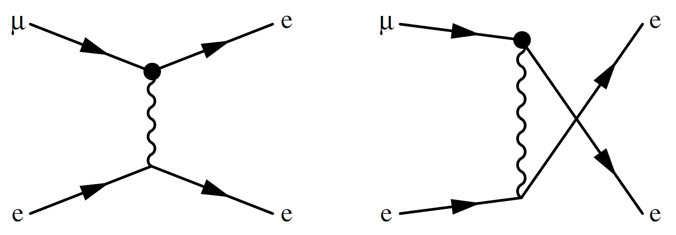
μ
e
e
e
Effective Lagrangian
[ Y. Kuno and Y. Okada Rev. Mod. Phys. 73 (2001) ]
Photonic interaction type

Slide 23
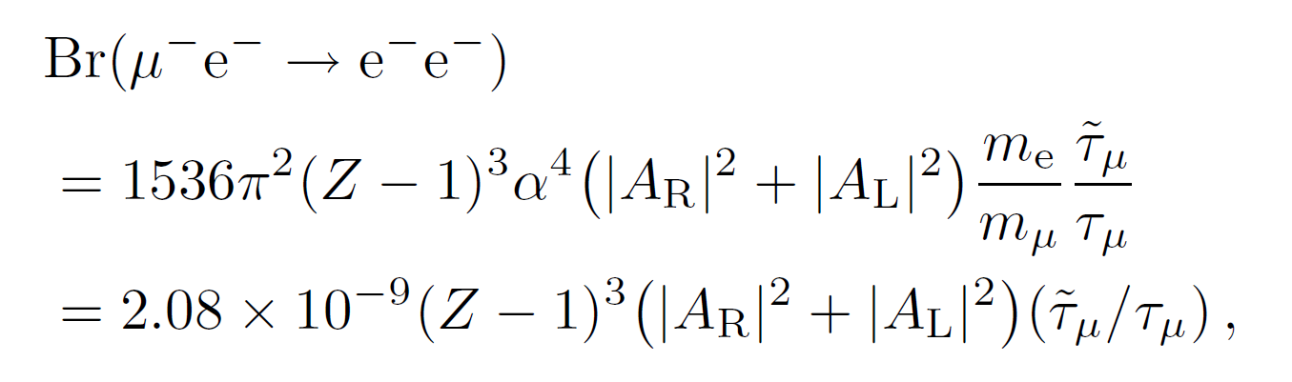
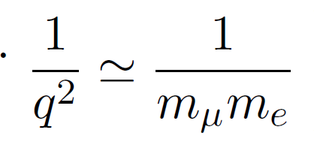
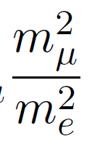
μ
e
e
e
Photonic interaction dominant case
Branching ratio
Photon propagator
in non-relativistic limit
Enhancement factor
compared with 4-Fermi case

Slide 24



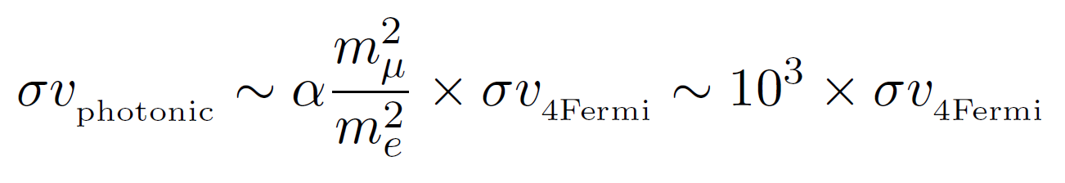
μ
e
e
e
Case : same order cLFV coupling
=
～
Ratio between photonic and 4-Fermi cross section
One of the distinct features for the process

Slide 25
Discovery reach
with the naïve estimate

Slide 26
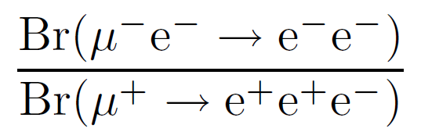
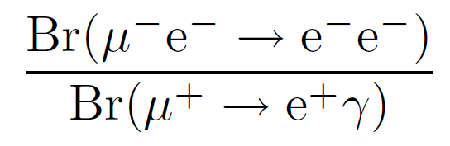
Discovery reach
μ
－
－
e
－
－
e
e
How to get upper limit for BR( )
Calculate ratio of the BR to other limited cLFV BR
4-Fermi interaction dominant case
Photonic interaction dominant case
These ratios are independent on cLFV effective coupling

Slide 27
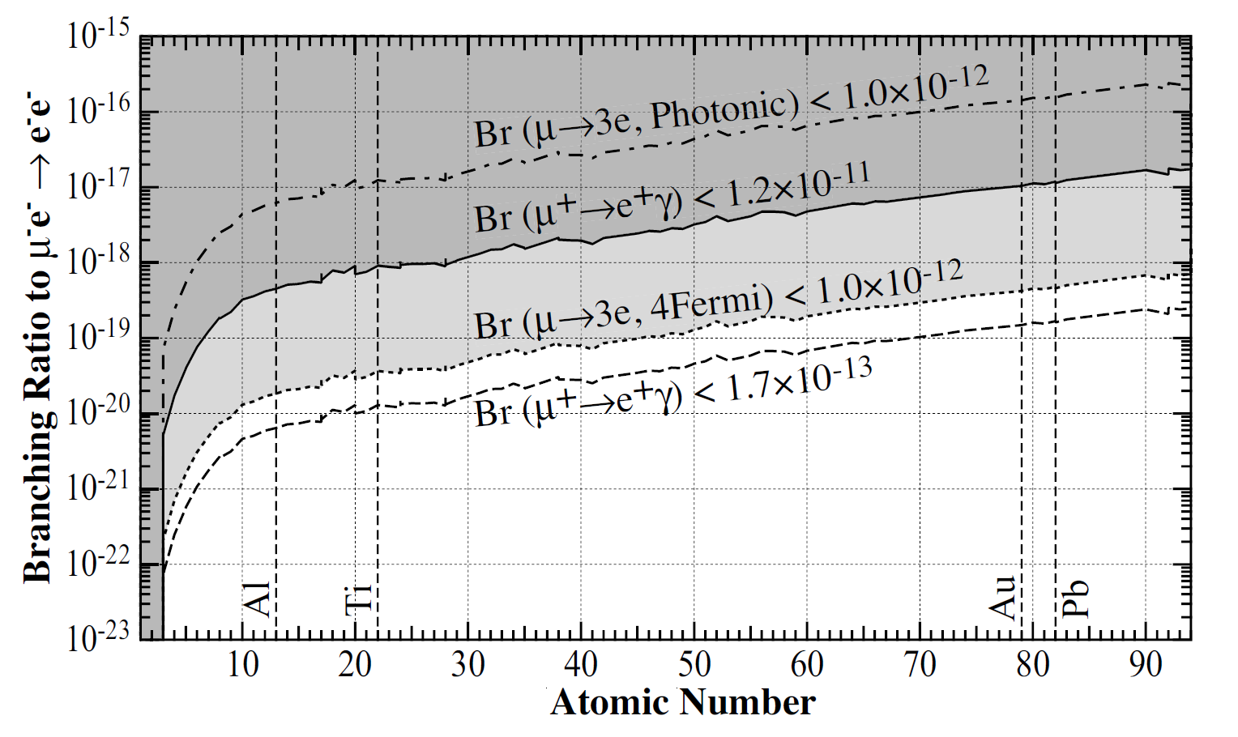
Discovery reach

Slide 28
Discovery reach
Current experimental bound in
4-Fermi interaction dominant case

Slide 29
Discovery reach
Current experimental bound in
photonic interaction dominant case

Slide 30
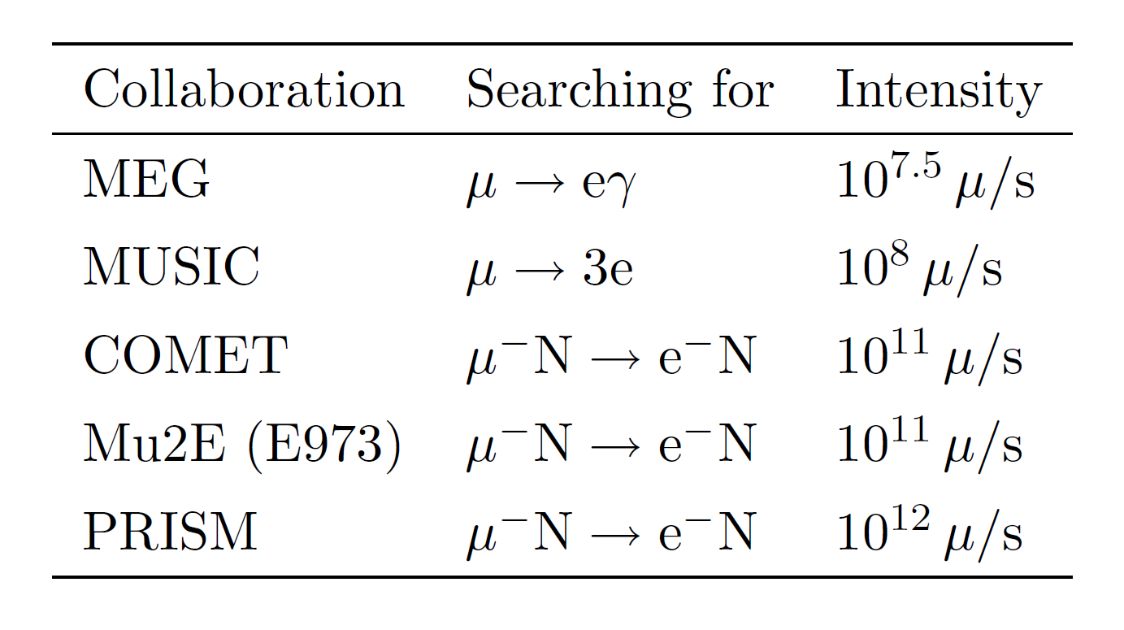
Discovery reach
7
For run-time 1 year 3 10 s
～
×
18
10
19
10
-
muon at COMET experiment

Slide 31
Discovery reach
μ
e
e
e
can be first signal of LFV !?

Slide 32

Discovery reach
Project | Intensity Reach
COMET / PRISM | 10¹⁸ – 10¹⁹ μ/year
ν factories | 10²¹ μ/year
With these number of muons the process will be seen !!

Slide 33
Precise Estimate

Slide 34
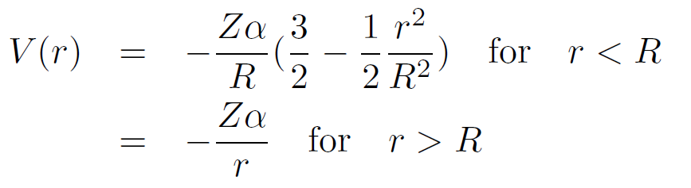

Precise Estimate
High Z nucleus is preferable
All leptons are under strong Coulomb potentail
Distorted wave function
Out-going electron is very energetic >>m_{e}
High Z means high velocity for bound leptons
Relativistic treatment
Nuclei is not a point charge
Numerical solution for Wave fns , integration for amplitude
Solve Dirac Eq. , integrate Wave funs, numerically
For trial, uniform charge density is assumed (not so important)

Slide 35
Dirac Eq. : Final State
Precise Estimate
Previous calculation(1)
Final electrons are described by plane wave
Though Out-going electrons are highly relativistic and its wave functions are distorted by nuclear Coulomb potential, especially for high Z
Improvement for scattered electrons
Coulomb scattering wave function of Dirac Eq. with finite size nucleus
Plane wave

Slide 36
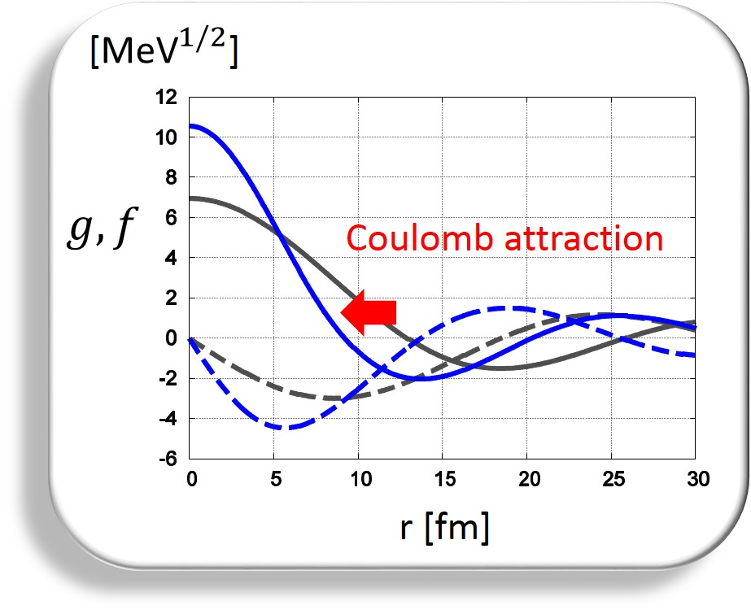
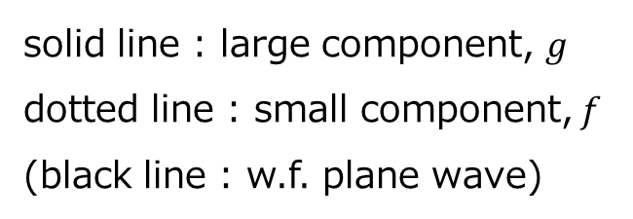
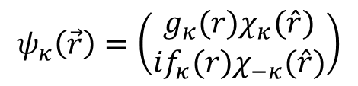
Precise Estimate
Dirac Eq. : Final State
$$ψ_{κ}\left(\vec{r}\right)=\left(\begin{matrix}g_{κ}(r)χ_{κ}(\hat{r}) \\ if_{κ}(r)χ_{−κ}(\hat{r})\end{matrix}\right)$$
solid line : large component, $g$
dotted line : small component, $f$
(black line : w.f. plane wave)
Wave fun. near the center position becomes larger, which
leads enhancement of the overlap and hence reaction rate
Muon is located at r<O(10) fm
Improvement for scattered electrons
Coulomb scattering wave function of Dirac Eq. with finite size nucleus
Plane wave

Slide 37
Precise Estimate
Dirac Eq. : Bound electron
Previous calculation (2)
Non-relativistic electron wave function for bound state
The bound electron is a relativistic Dirac particle
>
>
Electron orbit radius Nucleus size
Improvement for bound electron
Wave function of Dirac particle in point Coulomb potential
NR wave function

Slide 38
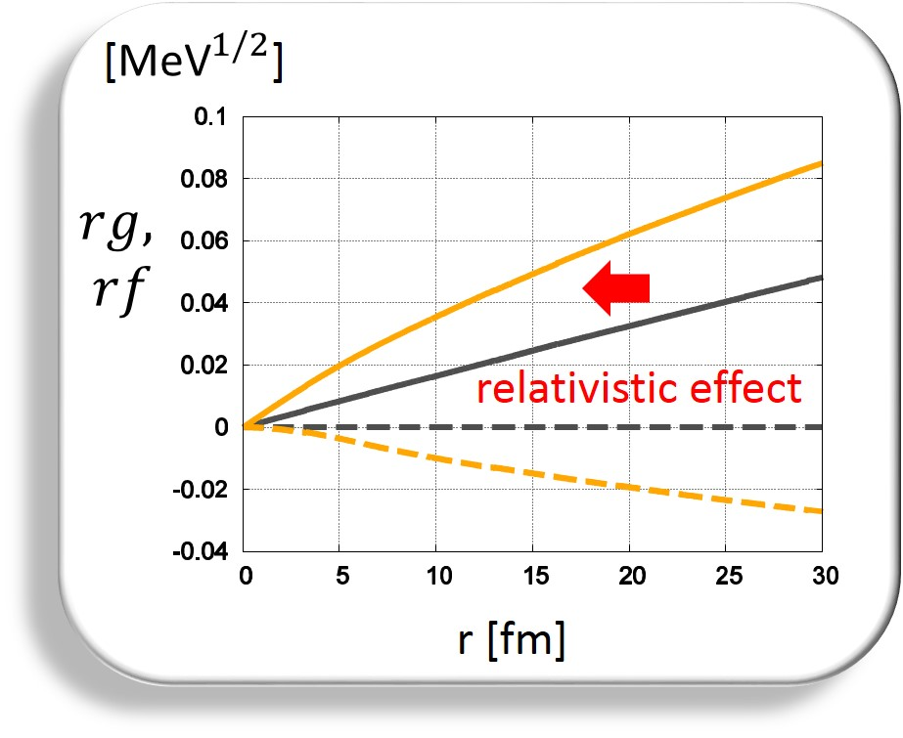
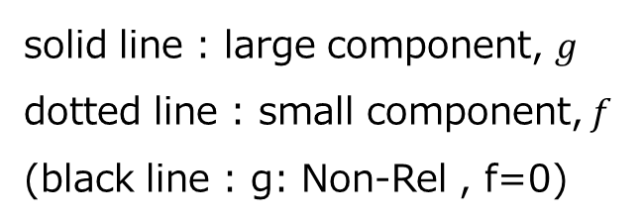
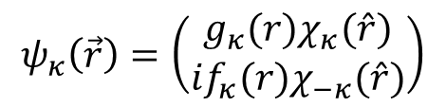
Precise Estimate
Dirac Eq. : Bound electron
$$ψ_{κ}\left(\vec{r}\right)=\left(\begin{matrix}g_{κ}(r)χ_{κ}(\hat{r}) \\ if_{κ}(r)χ_{−κ}(\hat{r})\end{matrix}\right)$$
solid line : large component, $g$
dotted line : small component, $f$
(black line : g: Non-Rel , f=0)
Muon is located at r<O(10) fm
More attracted, leading enhancement of the overlap
Improvement for bound electron
Wave function of Dirac particle in point Coulomb potential
NR wave function

Slide 39
Precise Estimate
Dirac Eq. : Bound muon
Previous Calculation (3)
Muon is localized at nucleus position
Muon is not at center but spread around nucleus
Improvement for bound muon
Wave function of Dirac particle in Coulomb potential by finite size nucleus
Localized muon wave function

Slide 40
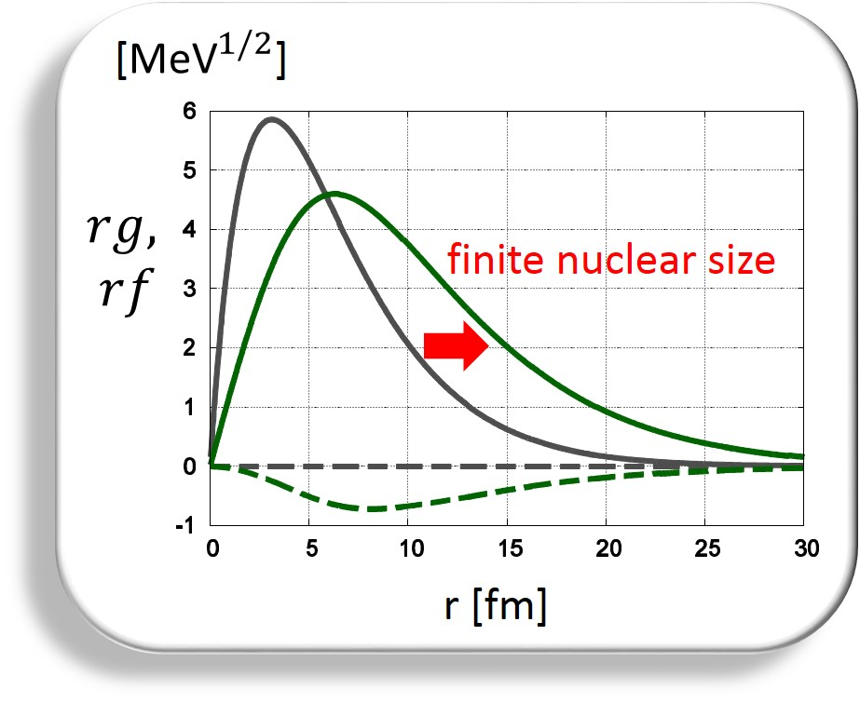
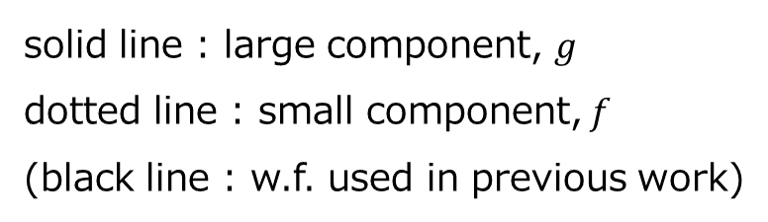
Precise Estimate
Dirac Eq. : Bound muon
$$ψ_{κ}\left(\vec{r}\right)=\left(\begin{matrix}g_{κ}(r)χ_{κ}(\hat{r}) \\ if_{κ}(r)χ_{−κ}(\hat{r})\end{matrix}\right)$$
solid line : large component, $g$
dotted line : small component, $f$
(black line : w.f. used in previous work)
Density near the center position becomes smaller,
leading decline of the overlap and hence the reaction rate
Improvement for bound muon
Wave function of Dirac particle in Coulomb potential by finite size nucleus
Localized muon wave function

Slide 41
Numerical results (improved analysis)

Slide 42
Reaction rate for contact interactions
Reaction rate for contact ints.
(Amplitude)² up to J
κ：(total angular + orbital) momentum for
scattered electron
cLFV interactions Physics !!
Overlap of wave functions

Slide 43
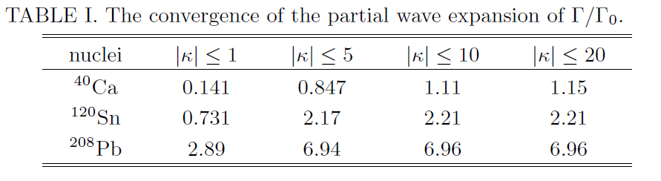
High angular momentum is very important
Γ₀ : previous calculation

Slide 44

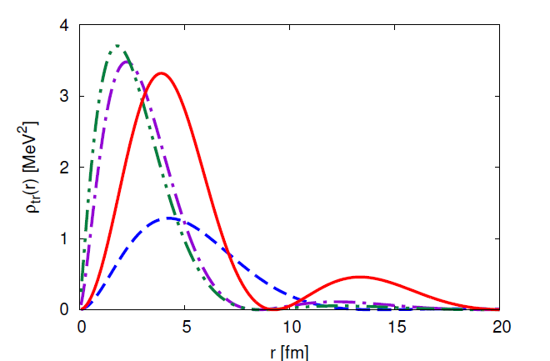

Overlap of wave functions
enhancement
Line : current
Dashed: previous

Slide 45
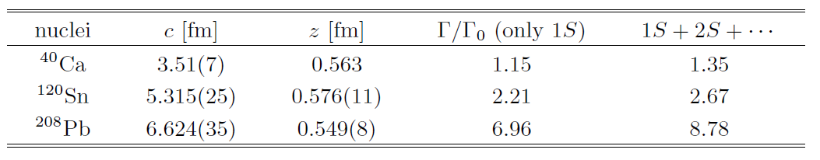
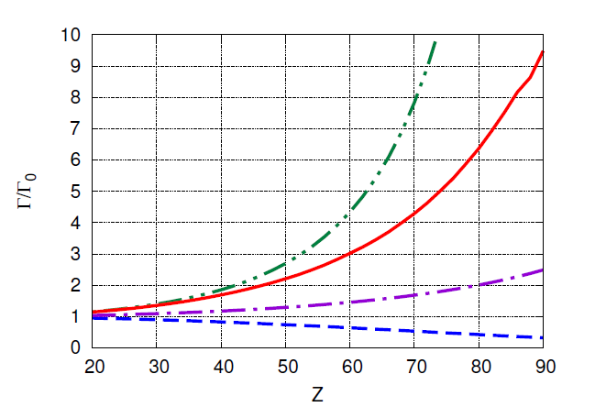
Not only 1S but also 2S, …, contribute
Rate : much larger

Slide 46
Numerical result
Excluded
Enhancement
Upper bound
with μ 3e current limit
Large enhancement of the reaction rate by the improvements
Especially the improvements of electron wave functions
−18
Example: upper bound for pb nucleus ~3.5 10

Slide 47
The reason of enhancement
Wave function of initial electron approaches to nucleus
Increase of overlap
Wave function density of muon at nucleus becomes smaller
Decrease of overlap
Wave functions of final electron also approach
to nucleus
Increase of overlap
As a total
Enhancement

Slide 48













Energy and angular disribution (g1)
$$g_{1}\left(\overline{e_{L}}μ_{R}\right)\left(\overline{e_{L}}e_{R}\right)$$
Muon is not point-like →distribution is spread
$$Z=82$$
$E_{1}$ : energy of scattered electrion
$θ$ : angle between scattered electrons
$$\frac{1}{Γ}\frac{dΓ}{dE_{1}}$$
$$[{MeV}^{−1}]$$
$$E_{1}$$
$$\frac{1}{Γ}\frac{dΓ}{dcosθ}$$
$$θ$$
$$E_{1}$$
Coulomb DW
Coulomb DW
PLW
PLW
$E_{1}$ $[MeV]$
$$cosθ$$
$m_{e}≤E_{1}≤m_{μ}−B_{μ}−B_{e}$
Almost back to back
Peak at half value

Slide 49
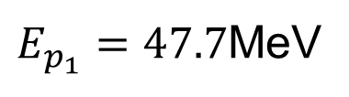
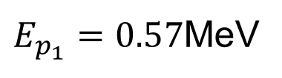


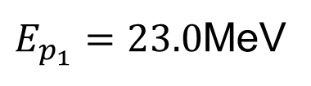

Slide 50





Angular dependence of energy distribution(g1)

Slide 51
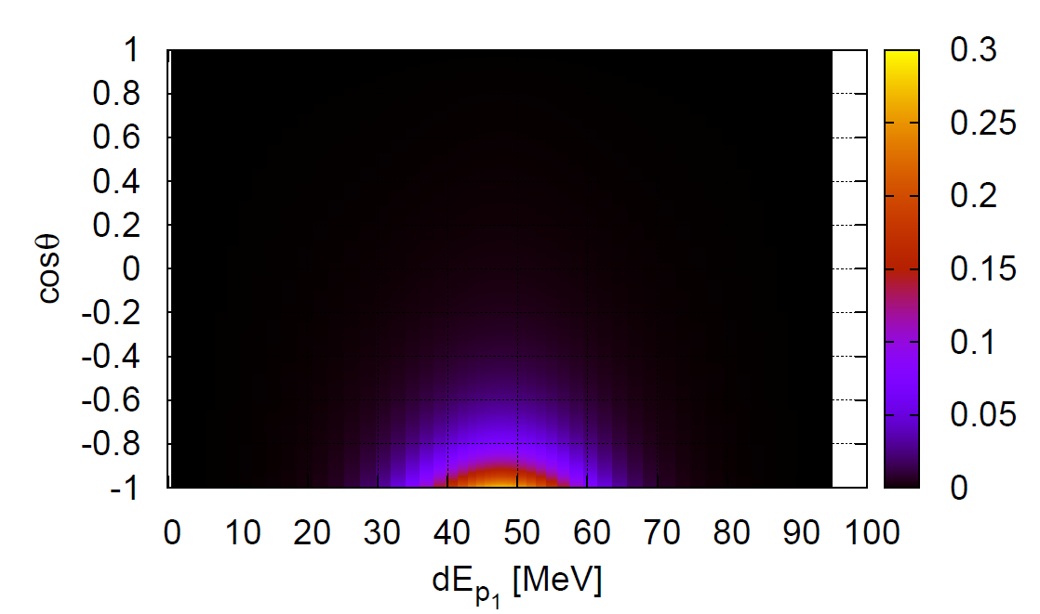

Angle and energy distribution(g1)
$$g_{1}\left(\overline{e_{L}}μ_{R}\right)\left(\overline{e_{L}}e_{R}\right)$$
$$Z=82$$
“3D” plot

Slide 52


Slide 53
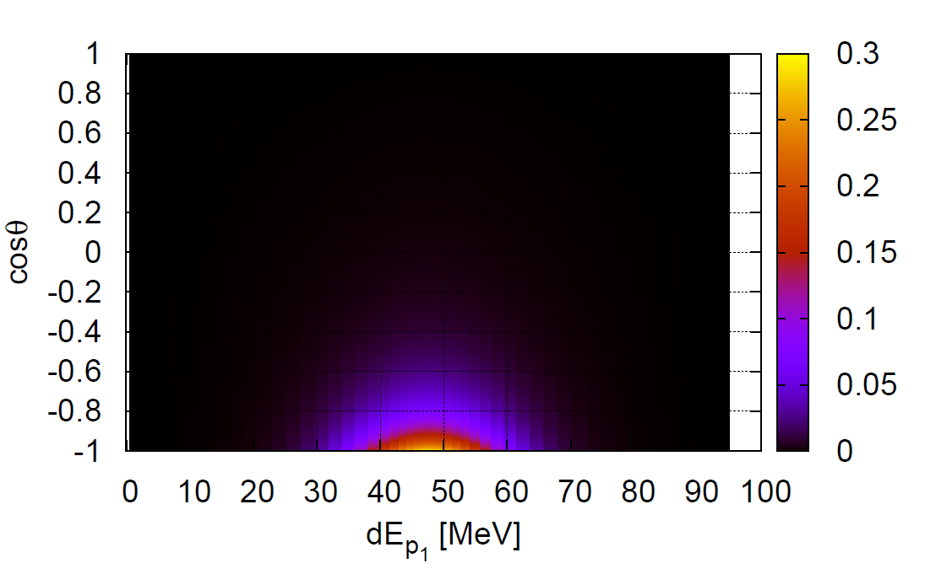

Angle and energy distribution(g1)
$$g_{5}\left(\overline{e_{R}}γ_{μ}μ_{R}\right)\left(\overline{e_{L}}γ^{μ}e_{L}\right)$$
$$Z=82$$
“3D” plot

Slide 54



Angular distribution(forward)
$$Z=82$$
$$g_{5}\left(\overline{e_{R}}γ_{μ}μ_{R}\right)\left(\overline{e_{L}}γ^{μ}e_{L}\right)$$
difference
$$g_{1}\left(\overline{e_{L}}μ_{R}\right)\left(\overline{e_{L}}e_{R}\right)$$
同chiralityの電子が出る相互作用では同じ方向に出る場合がより抑制される (Pauli原理)

Slide 55
Discussion (photonic dipole Interaction)

Slide 56
Cross section of cLFV elemental process
cLFV effective Lagrangian
Dipole photonic interaction

Slide 57
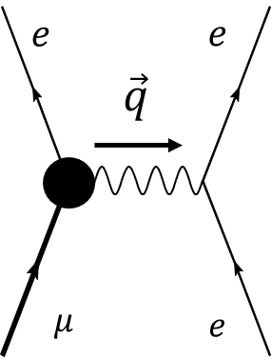
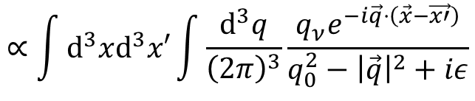

Photonic interaction: Long-range force
Photon propagator : infrared divergent
$$q_{0}=p_{1}−E_{μ}=E_{e}−p_{2}$$
$$ℳ\left(p_{1},s_{1};p_{2},s_{2};1S,s_{μ};n,s_{e}\right)≡\left\langle e\left(p_{1},s_{1}\right);e\left(p_{2},s_{2}\right) | H | μ\left(1S,s_{μ}\right);e\left(n,s_{e}\right)\right\rangle$$
$$∝\int{d^{3}xd^{3}x′}\int{\frac{d^{3}q}{{\left(2π\right)}^{3}}}\frac{q_{ν}e^{−i\vec{q}⋅\left(\vec{x}−\vec{x′}\right)}}{q_{0}^{2}−{\left|\vec{q}\right|}^{2}+iε}$$
$$×\overline{ψ_{e}^{p_{1},s_{1}}}\left(\vec{x}\right)σ^{μν}ψ_{μ}^{1S,s_{μ}}\left(\vec{x}\right)\overline{ψ_{e}^{p_{2},s_{2}}}\left(\vec{x′}\right)γ_{μ}ψ_{e}^{n,s_{e}}\left(\vec{x′}\right)−\left(1↔2\right)$$
Scattered electrons (Coulomb distorted)
Bound leptons
Infrared divergent , especially for high Z

Slide 58
Summary

Slide 59
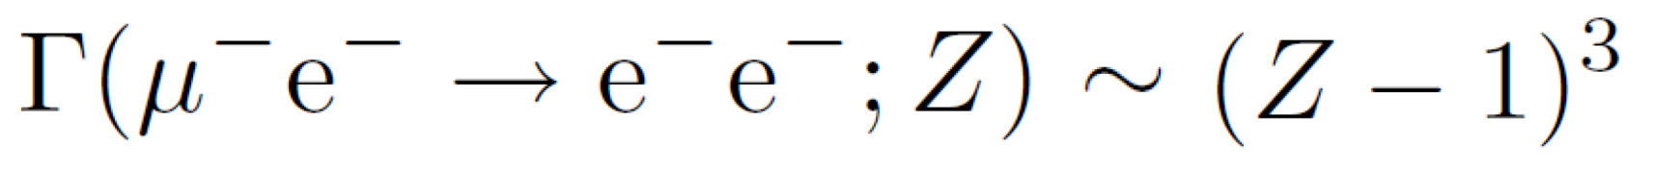
Summary
μ
e
－
－
e
－
e
New LFV process
－
in muonic atom
Clean signal (back to back electron with E m /2)
～
=
e
μ
Interaction rate
Advantage : Large nucleus
Detectable in on-going or future experiments
Observation at COMET
See COMET Phase-1 Technical Report
201524001 [A/H] KEK Report 2015-1
We wish to observe LFV in the process

Slide 60
Backup slides

Slide 61
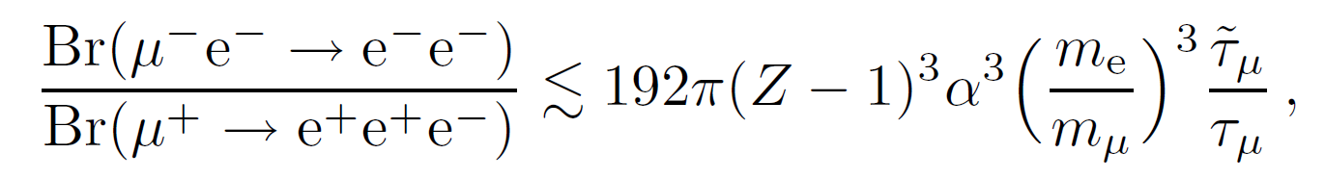
Numerical result (previous work)
The new process and μ 3e are described by same operator
Relation between upper bounds of the new process and μ 3e
Large enhancement by
large nucleus charge
Excluded
Example: Upper bound
for Pb nucleus ~ 5 10
−19

