Slide 1
Winding Number and Zak Phase
Hsien-chung Kao
National Taiwan Normal University

Slide 2
Outlines
Introduction
Topological Insulators (TI) and Topological Superconductors
Zak Phase and Winding numbere
Discussions and Conclusions

Slide 3
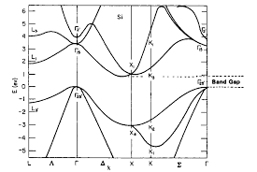
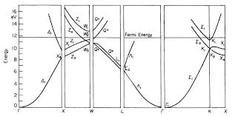
Insulator and Metal
Insulator:
Metal:

Slide 4
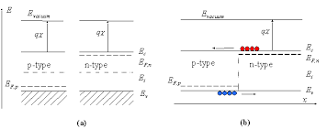

Semiconductor
Semiconductor:
IC:

Slide 5
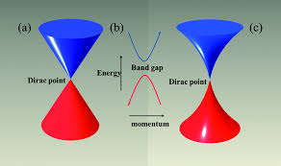
Semi-metal
Semi-metal:

Slide 6
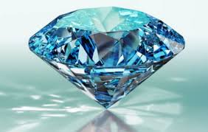

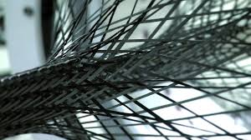
Allotropes of Carbon
Diamond:
Graphite:

Slide 7
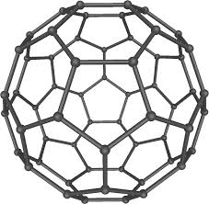
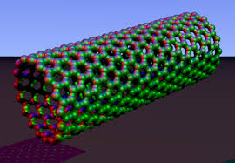
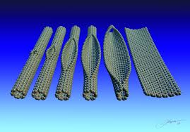
Fullerene and Carbon Nano-Structures
Fullerene: icosahedron
Carbon nano-tube and nano-ribbon

Slide 8
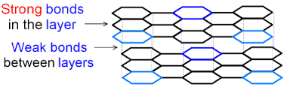
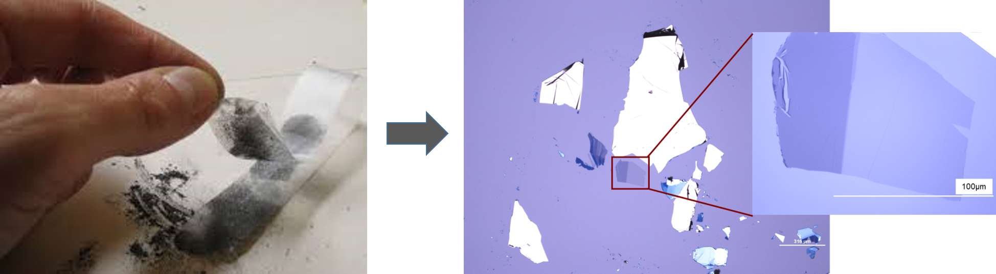
Scotch-tape Exfoliation

Slide 9
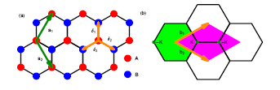
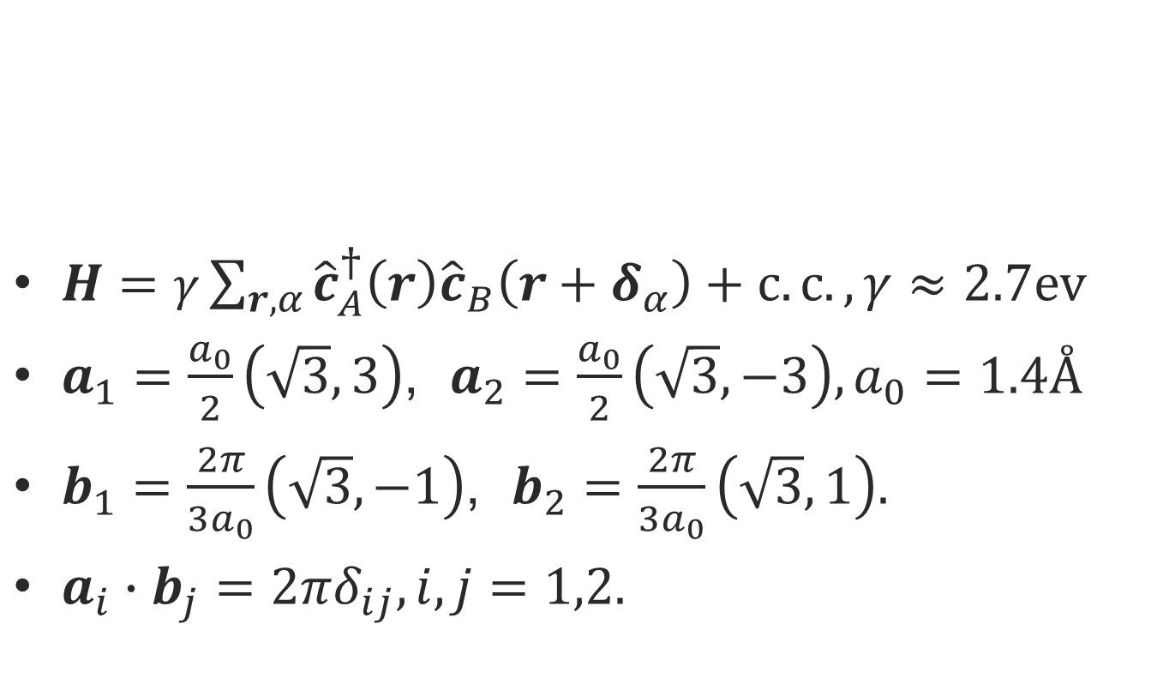
Graphene I
$H=γ\sum_{r,α}{{\hat{c}}_{A}^{†}\left(r\right){\hat{c}}_{B}\left(r+δ_{α}\right)+c.c.,γ≈2.7ev }$
$a_{1}=\frac{a_{0}}{2}\left(\sqrt{3},3\right)$, $a_{2}=\frac{a_{0}}{2}\left(\sqrt{3},−3\right), a_{0}=1.4Å$
$b_{1}=\frac{2π}{3a_{0}}\left(\sqrt{3},−1\right)$, $b_{2}=\frac{2π}{3a_{0}}\left(\sqrt{3},1\right).$
$a_{i}∙b_{j}=2πδ_{ij}, i,j=1,2.$

Slide 10
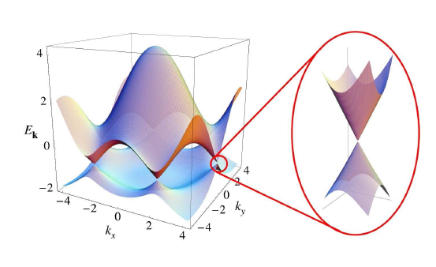
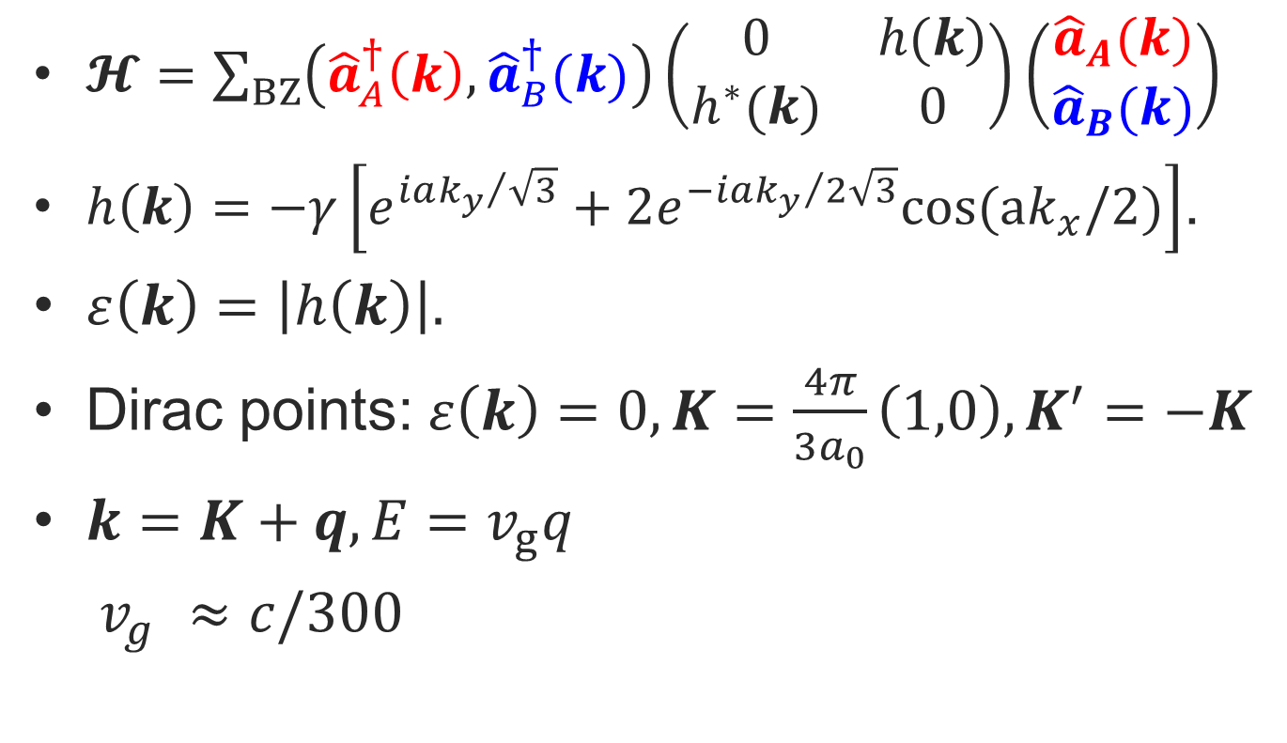
Graphene II
$𝓗=\sum_{BZ}{\left({\hat{a}}_{A}^{†}\left(k\right),{\hat{a}}_{B}^{†}(k)\right)}\left(\begin{matrix}0 & h(k) \\ h^{∗}(k) & 0\end{matrix}\right)\left(\begin{matrix}{\hat{a}}_{A}(k) \\ {\hat{a}}_{B}(k)\end{matrix}\right)$
$h\left(k\right)=−γ\left[e^{{iak_{y}}/{\sqrt{3}}}+2e^{−{iak_{y}}/{2\sqrt{3}}}cos(ak_{x}/2)\right]$.
$ε\left(k\right)=\left|h\left(k\right)\right|.$
Dirac points: $ε\left(k\right)=0,K=\frac{4π}{3a_{0}}\left(1,0\right), K^{′}=−K$
$k=K+q, E=v_{g}q$
$v_{g }≈c/300$

Slide 11
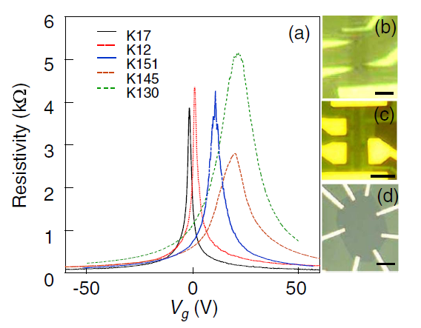

Graphene III
Minimal conductivity：
$$σ_{0}=e^{2}/(4ℏ)$$

Slide 12
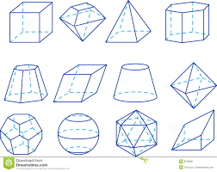
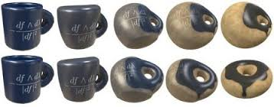
Geometry and Topology

Slide 13
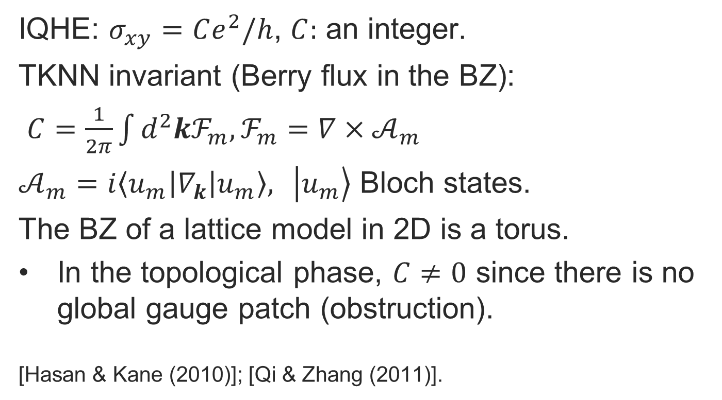
Berry Curvature & TKNN Invariant
IQHE: $σ_{xy}=Ce^{2}/h$, $C:$ an integer.
TKNN invariant (Berry flux in the BZ):
$C=\frac{1}{2π}\int{d^{2}kℱ_{m}, ℱ_{m}={∇×𝒜}_{m}}$
$𝒜_{m}=i\left\langle u_{m}\left|∇_{k}\right|u_{m}\right\rangle , \left. \left|u_{m}\right.\right\rangle$ Bloch states.
The BZ of a lattice model in 2D is a torus.
In the topological phase, $C≠0$ since there is no global gauge patch (obstruction).
[Hasan & Kane (2010)]; [Qi & Zhang (2011)].

Slide 14
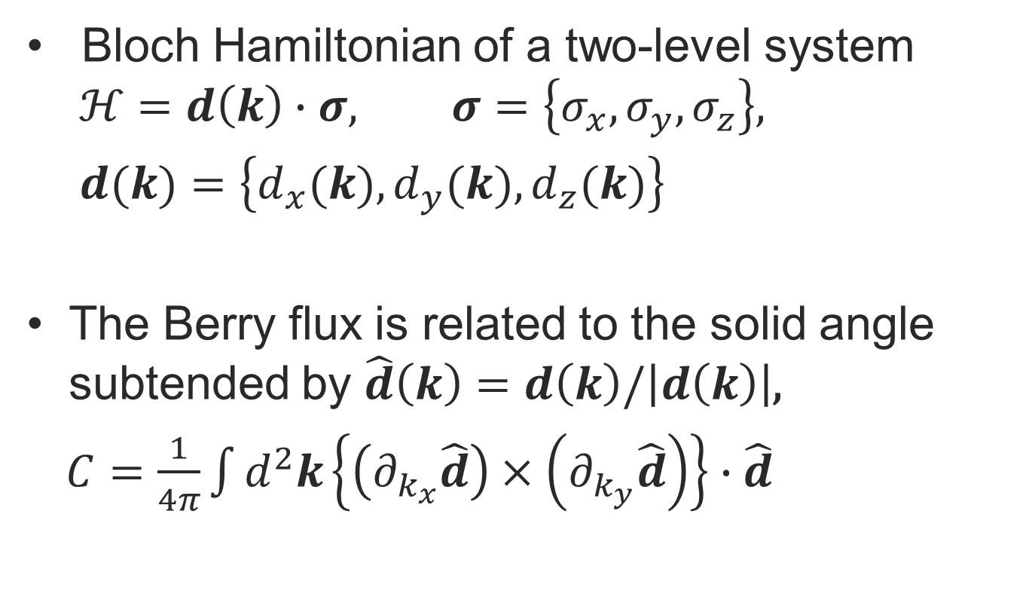
Two-level System and Chern Number
Bloch Hamiltonian of a two-level system
$$ℋ=d\left(k\right)∙σ, σ=\left\{σ_{x},σ_{y},σ_{z}\right\},$$
$d(k)=\left\{d_{x}(k),d_{y}(k),d_{z}(k)\right\}$
The Berry flux is related to the solid angle subtended by $\hat{d}\left(k\right)=d\left(k\right)/\left|d\left(k\right)\right|$,
$C=\frac{1}{4π}\int{d^{2}k\left\{\left(∂_{k_{x}}\hat{d}\right)×\left(∂_{k_{y}}\hat{d}\right)\right\}∙\hat{d}}$

Slide 15
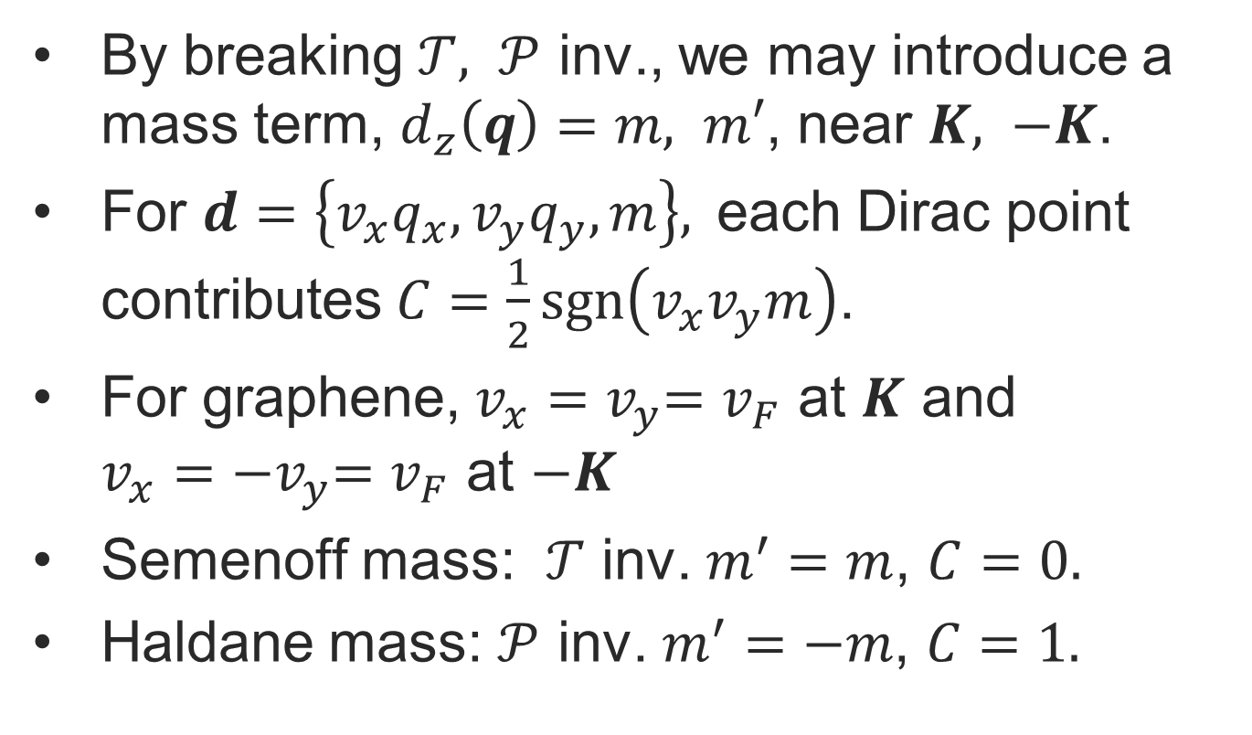
Graphene and Chern Insulator
By breaking $𝒯, 𝒫$ inv., we may introduce a mass term, $d_{z}\left(q\right)=m, m′$, near $K, −K$.
For $d=\left\{v_{x}q_{x},v_{y}q_{y}, m\right\},$ each Dirac point contributes $C=\frac{1}{2}sgn\left(v_{x}v_{y}m\right)$.
For graphene, $v_{x}{=v}_{y}=v_{F}$ at $K$ and $v_{x}{=−v}_{y}=v_{F}$ at $−K$
Semenoff mass: $𝒯$ inv. $m^{′}=m$, $C=0.$
Haldane mass: $𝒫$ inv. $m^{′}=−m$, $C=1.$

Slide 16
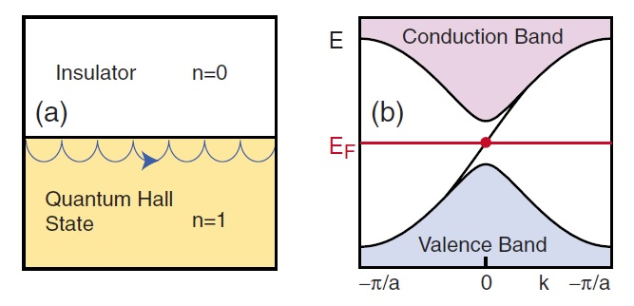
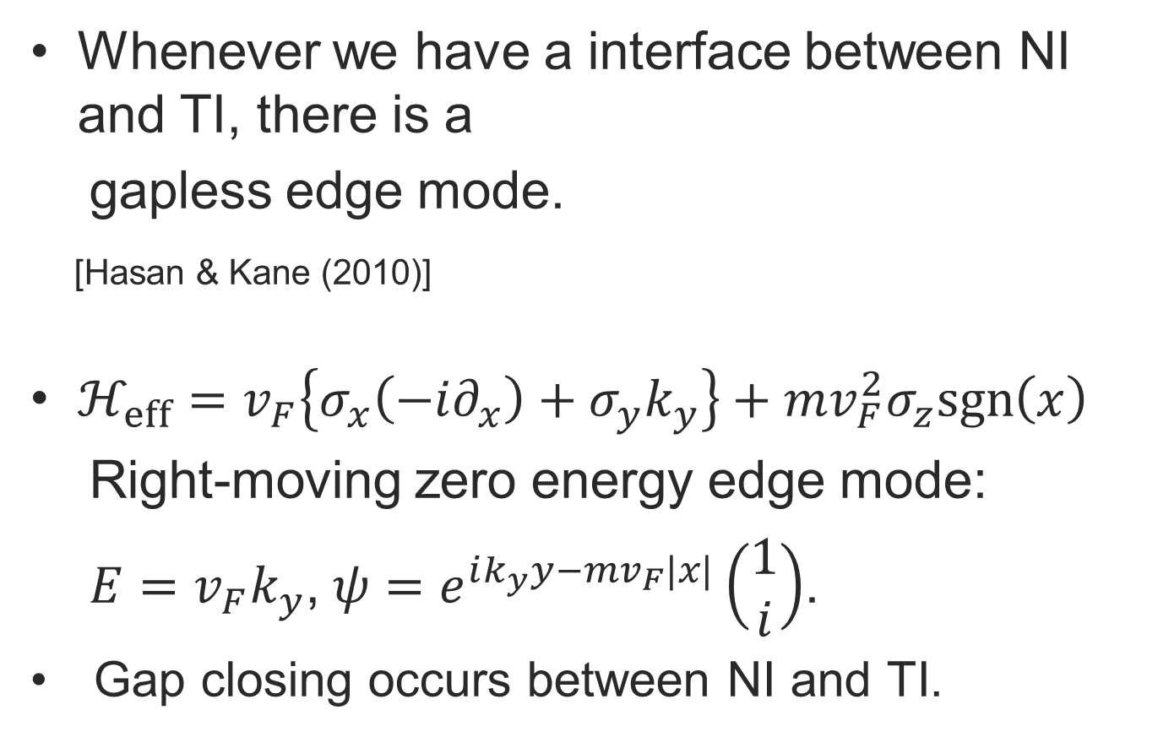
Zero Energy Edge Mode
Whenever we have a interface between NI and TI, there is a
gapless edge mode.
[Hasan & Kane (2010)]
$ℋ_{eff}=v_{F}\left\{σ_{x}\left(−i∂_{x}\right)+σ_{y}k_{y}\right\}+mv_{F}^{2}σ_{z}sgn\left(x\right)$
Right-moving zero energy edge mode:
$E=v_{F}k_{y}$,$ψ=e^{ik_{y}y−mv_{F}|x|}\left(\begin{matrix}1 \\ i\end{matrix}\right)$.
Gap closing occurs between NI and TI.

Slide 17
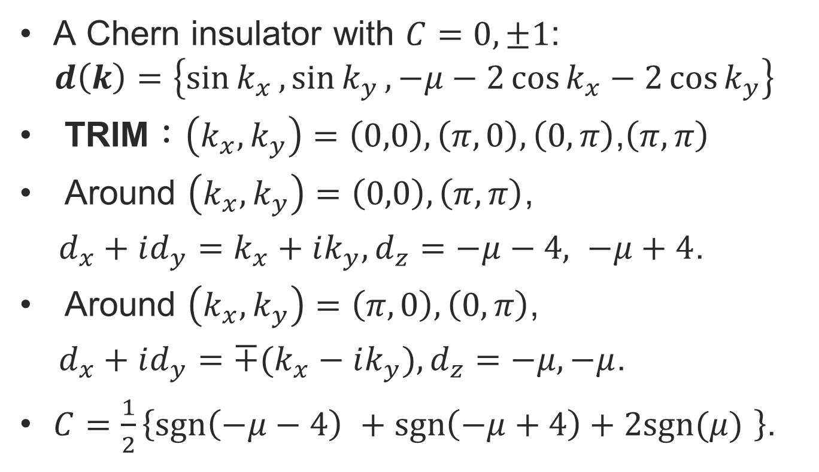
Chern Number and Chern Insulator I
A Chern insulator with $C=0,±1$:
$$d\left(k\right)=\left\{\sin{k_{x}},\sin{k_{y}},−μ−2\cos{k_{x}}−2\cos{k_{y}}\right\}$$
TRIM：$\left(k_{x},k_{y}\right)=\left(0,0\right),\left(π,0\right), \left(0,π\right)\text{,}\left(π,π\right)$
Around $\left(k_{x},k_{y}\right)=\left(0,0\right), \left(π,π\right)$,
${d_{x}+id_{y}=k_{x}+ik_{y}, d}_{z}=−μ−4, −μ+4$.
Around $\left(k_{x},k_{y}\right)=\left(π,0\right), \left(0,π\right)$,
$d_{x}+id_{y}={∓(k}_{x}−ik_{y}),d_{z}=−μ, −μ$.
$C=\frac{1}{2}\left\{sgn\left(−μ−4\right) +sgn\left(−μ+4\right)+2sgn(μ) \right\}$.

Slide 18
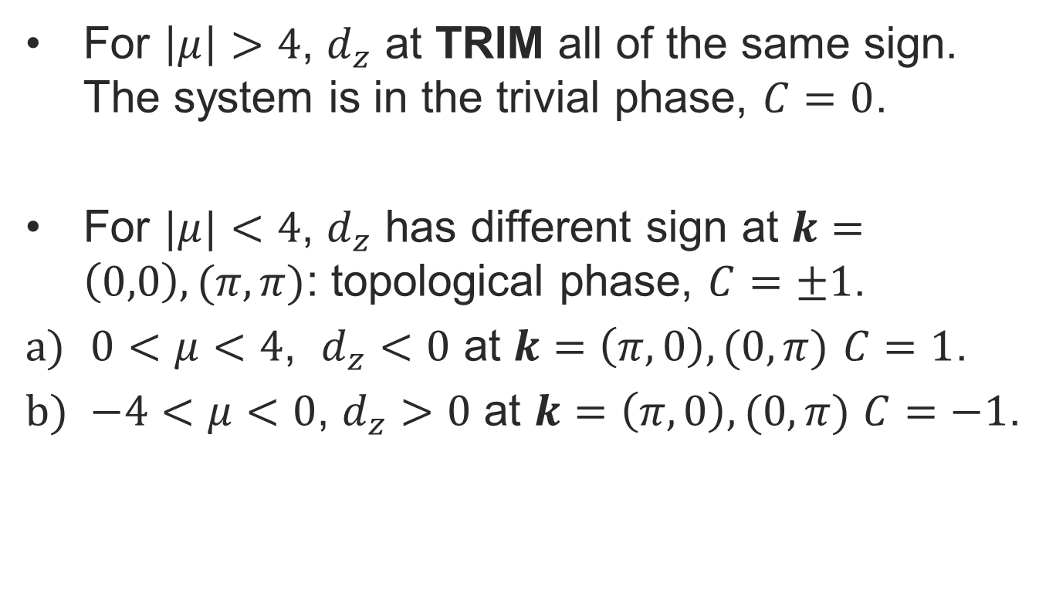
Chern Number and Chern Insulator II
For $\left|μ\right|>4$, $d_{z}$ at TRIM all of the same sign. The system is in the trivial phase, $C=0$.
For $|μ|<4$, $d_{z}$ has different sign at $k=\left(0,0\right), (π,π)$: topological phase, $C=±1$.
$0<μ<4$, $d_{z}<0$ at $k=\left(π, 0\right), (0,π)$ $C=1$.
$−4<μ<0$, $d_{z}>0$ at $k=\left(π, 0\right), (0,π)$ $C=−1$.

Slide 19
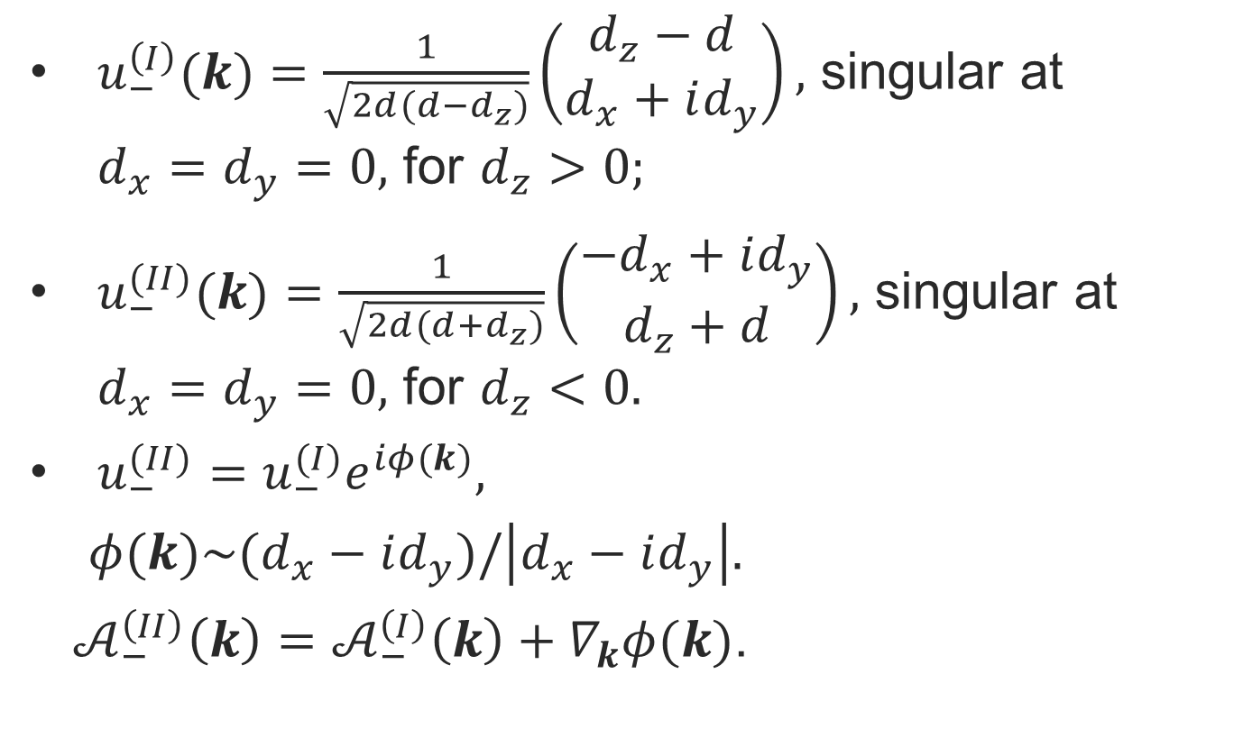
Chern Number and Chern Insulator III
$u_{−}^{\left(I\right)}(k)=\frac{1}{\sqrt{2d(d−d_{z})}}\left(\begin{matrix}d_{z}−d \\ d_{x}+id_{y}\end{matrix}\right),$ singular at $d_{x}=d_{y}=0,$ for $d_{z}>0;$
$u_{−}^{(II)}(k)=\frac{1}{\sqrt{2d(d+d_{z})}}\left(\begin{matrix}{−d}_{x}+id_{y} \\ d_{z}+d\end{matrix}\right),$ singular at $d_{x}=d_{y}=0,$ for $d_{z}<0.$
$u_{−}^{(II)}=u_{−}^{(I)}e^{iφ(k)},$
$φ(k)\sim (d_{x}−id_{y})/\left|d_{x}−id_{y}\right|.$
$𝒜_{−}^{\left(II\right)}\left(k\right)=𝒜_{−}^{\left(I\right)}\left(k\right)+∇_{k}φ(k)$.

Slide 20
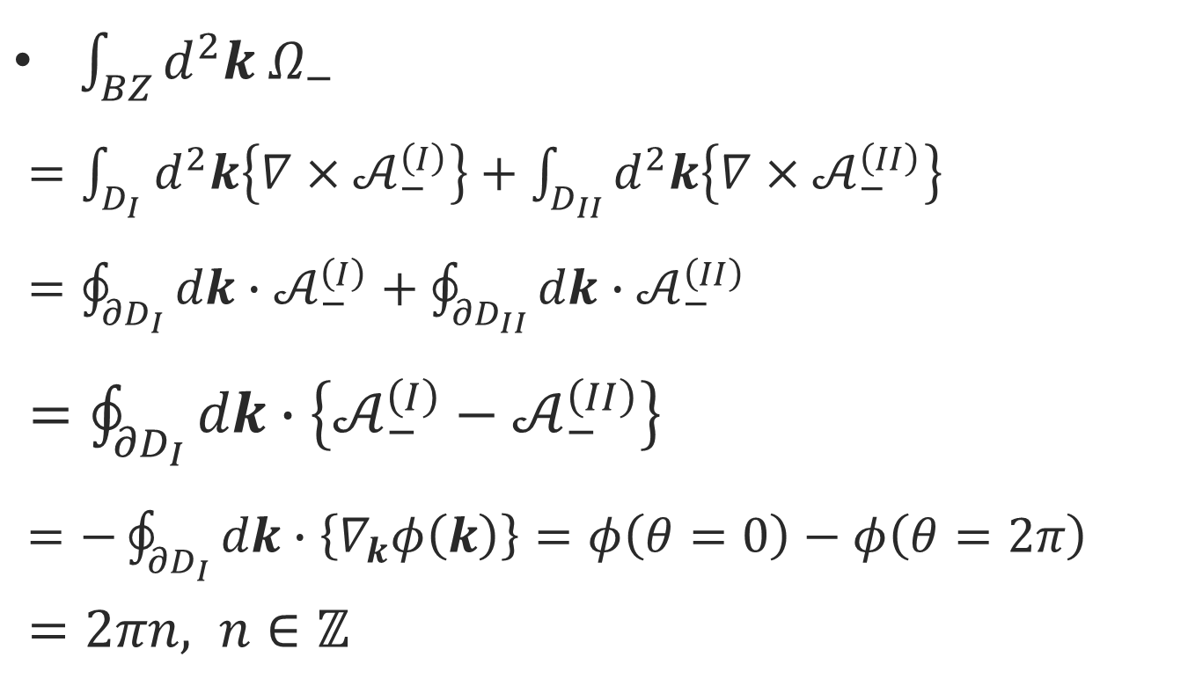
Chern Number and Chern Insulator IV
$\int_{BZ}{d^{2}k{ Ω}_{−}}$
$=\int_{D_{I}}{d^{2}k\left\{{∇×𝒜}_{−}^{\left(I\right)}\right\}}+\int_{D_{II}}{d^{2}k\left\{{∇×𝒜}_{−}^{\left(II\right)}\right\}}$
$=\oint_{{∂D}_{I}}{dk∙𝒜_{−}^{\left(I\right)}}+\oint_{{∂D}_{II}}{dk∙𝒜_{−}^{\left(II\right)}}$
$=\oint_{{∂D}_{I}}{dk∙\left\{𝒜_{−}^{\left(I\right)}−𝒜_{−}^{\left(II\right)}\right\}}$
$=−\oint_{{∂D}_{I}}{dk∙\left\{∇_{k}φ\left(k\right)\right\}}=φ\left(θ=0\right)−φ\left(θ=2π\right)$
$=2πn, n∈ℤ$

Slide 21
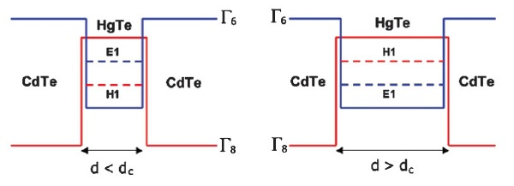
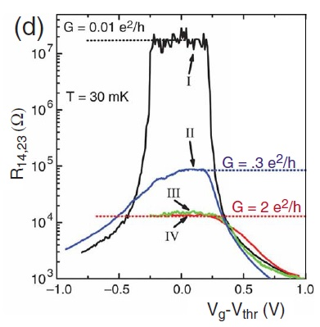
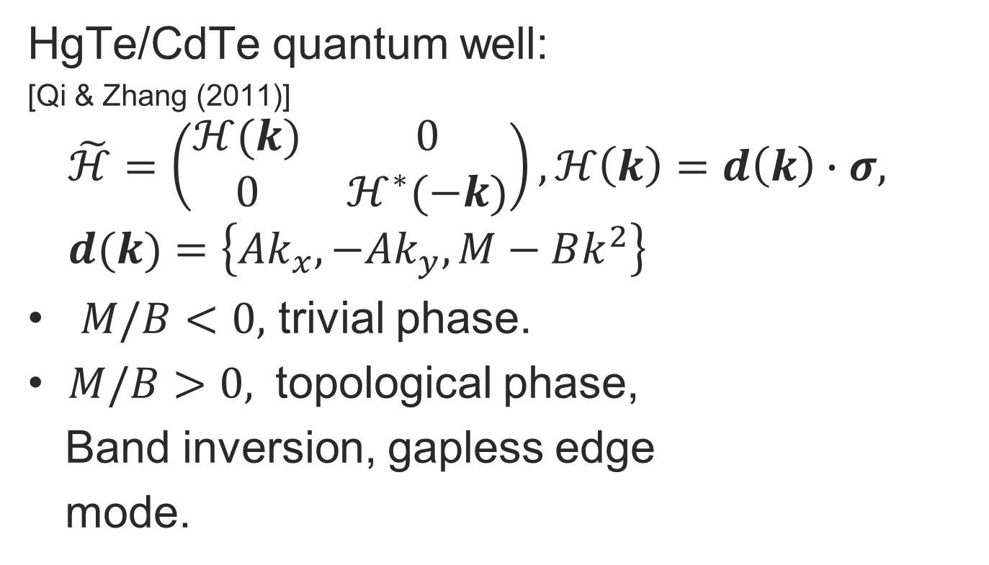
Experimental Evidence of TI
HgTe/CdTe quantum well:
[Qi & Zhang (2011)]
$$\tilde{ℋ}=\left(\begin{matrix}ℋ(k) & 0 \\ 0 & ℋ^{∗}(−k)\end{matrix}\right), ℋ\left(k\right)=d\left(k\right)∙σ,$$
$$d(k)=\left\{Ak_{x},{−Ak}_{y},M−Bk^{2}\right\}$$
$M/B<0,$ trivial phase.
$M/B>0,$ topological phase,
Band inversion, gapless edge
mode.

Slide 22
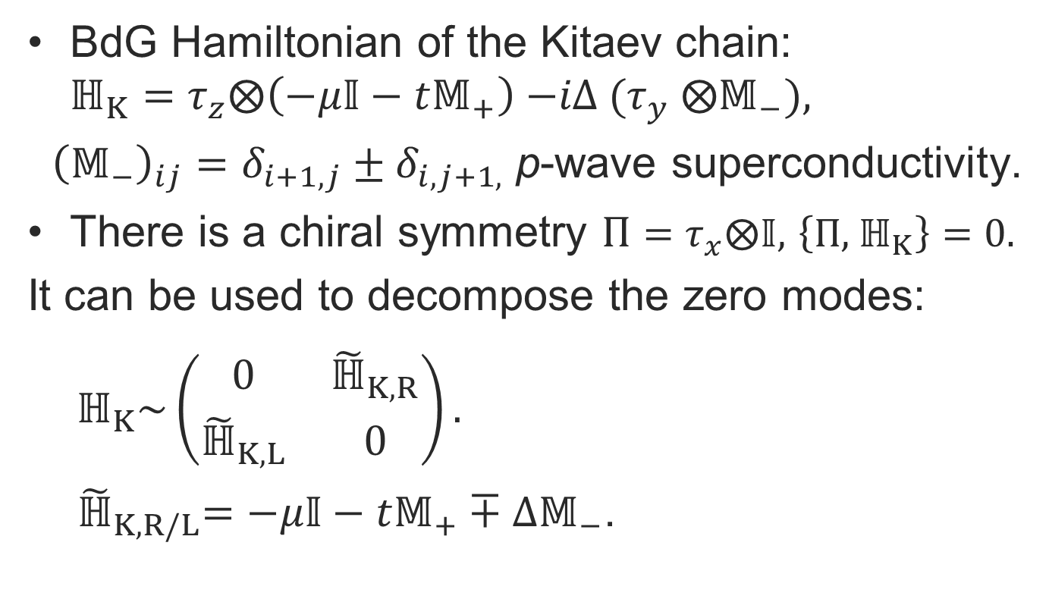
Topological Superconductor and Majorana Zero Energy State(MZES) I
BdG Hamiltonian of the Kitaev chain:
$$ℍ_{K}=τ_{z}⨂\left(−μ𝕀−t𝕄_{+}\right){−iΔ (τ}_{y}⨂𝕄_{−}),$$
${\left(𝕄_{−}\right)}_{ij}=δ_{i+1,j}±δ_{i,j+1,}$ p-wave superconductivity.
There is a chiral symmetry $Π=τ_{x}⨂𝕀,$ $\left\{Π,{ ℍ}_{K}\right\}=0.$
It can be used to decompose the zero modes:
$ℍ_{K}\sim \left(\begin{matrix}0 & {\tilde{ℍ}}_{K,R} \\ {\tilde{ℍ}}_{K,L} & 0\end{matrix}\right).$
${ \tilde{ℍ}}_{K,R/L}=−μ𝕀−t𝕄_{+}∓∆𝕄_{−}$.

Slide 23
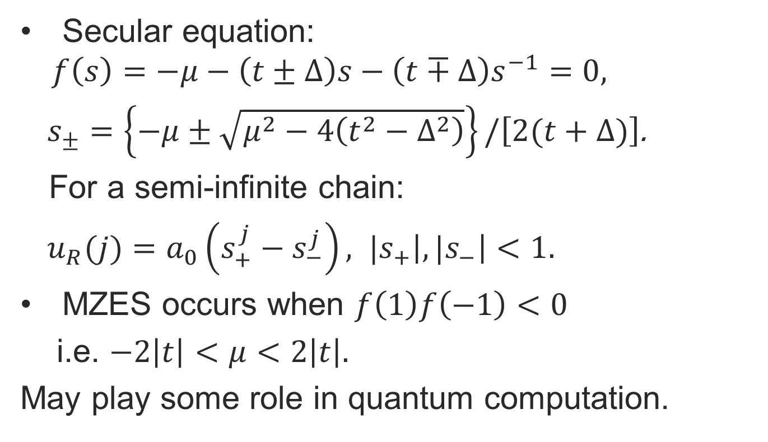
Topological Superconductor and Majorana Zero Energy State(MZES) II
Secular equation:
$$f\left(s\right)=−μ−\left(t±∆\right)s−\left(t∓∆\right)s^{−1}=0,$$
$s_{±}=\left\{−μ±\sqrt{μ^{2}−4\left(t^{2}−∆^{2}\right)}\right\}/\left[2(t+∆)\right]$.
For a semi-infinite chain:
$u_{R}(j)=a_{0}\left(s_{+}^{j}−s_{−}^{j}\right),$ ${|s}_{+}\left|,{|s}_{−}\right|<1.$
MZES occurs when $f\left(1\right)f\left(−1\right)<0$
i.e. $−2\left|t\right|<μ<2\left|t\right|.$
May play some role in quantum computation.

Slide 24
Experimental realization of Kitaev chain
Semiconductor nanowires on top of a s-wave superconductor.
To have a p-wave superconductor, need strong spin-orbit coupling.
Giving rise to zero-bias conductance.
Josephson current in S/TI/S junction.
Mourik et al, Science, 336, 1003 (2012)
Das et al, Nat. Phys. 8, 887 (2012).
Deng et al, Nano. Lett. 12, 6414 (2012)
Rokhinson et al, Nat. Phys. 8, 795 (2012).

Slide 25
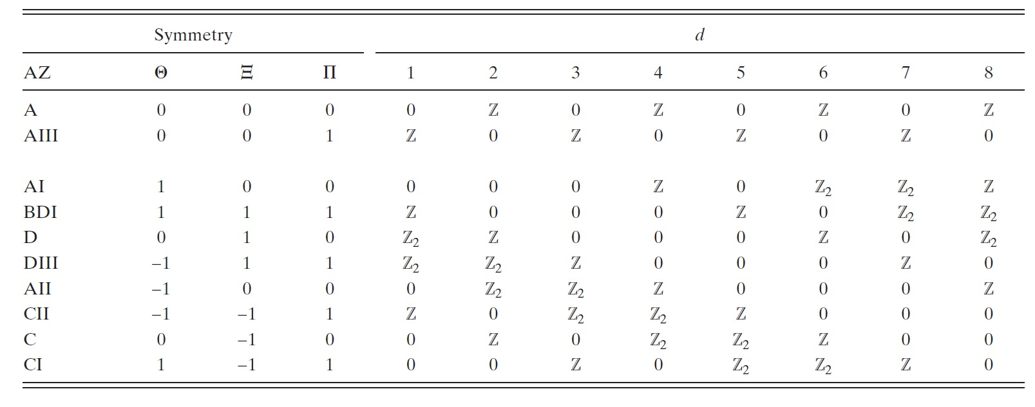
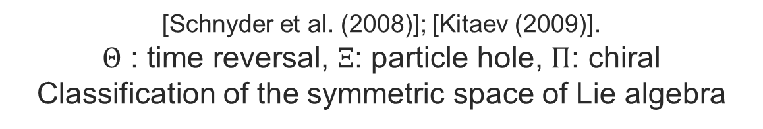
Periodic Table of TI
[Schnyder et al. (2008)]; [Kitaev (2009)].
$Θ$ : time reversal, $Ξ$: particle hole, $Π$: chiral
Classification of the symmetric space of Lie algebra

Slide 26
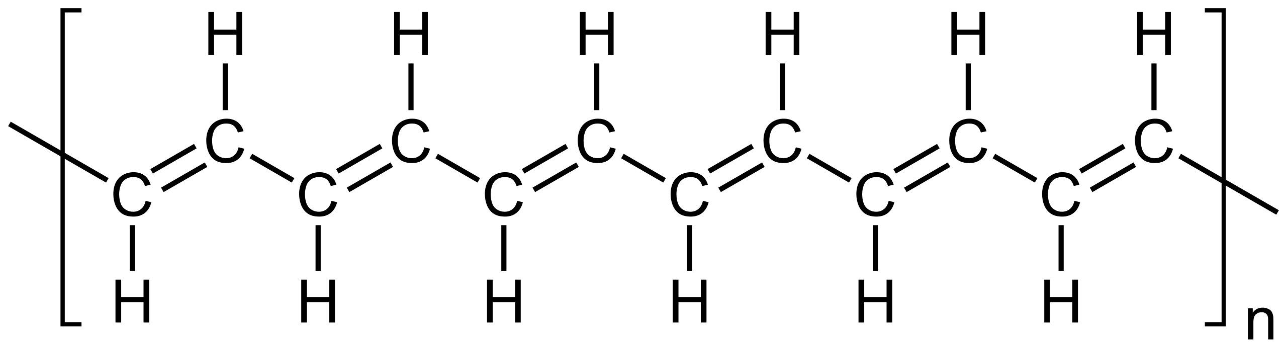
Polyacetylene
Conducting polymer
Dimmer:
Trimmer

Slide 27
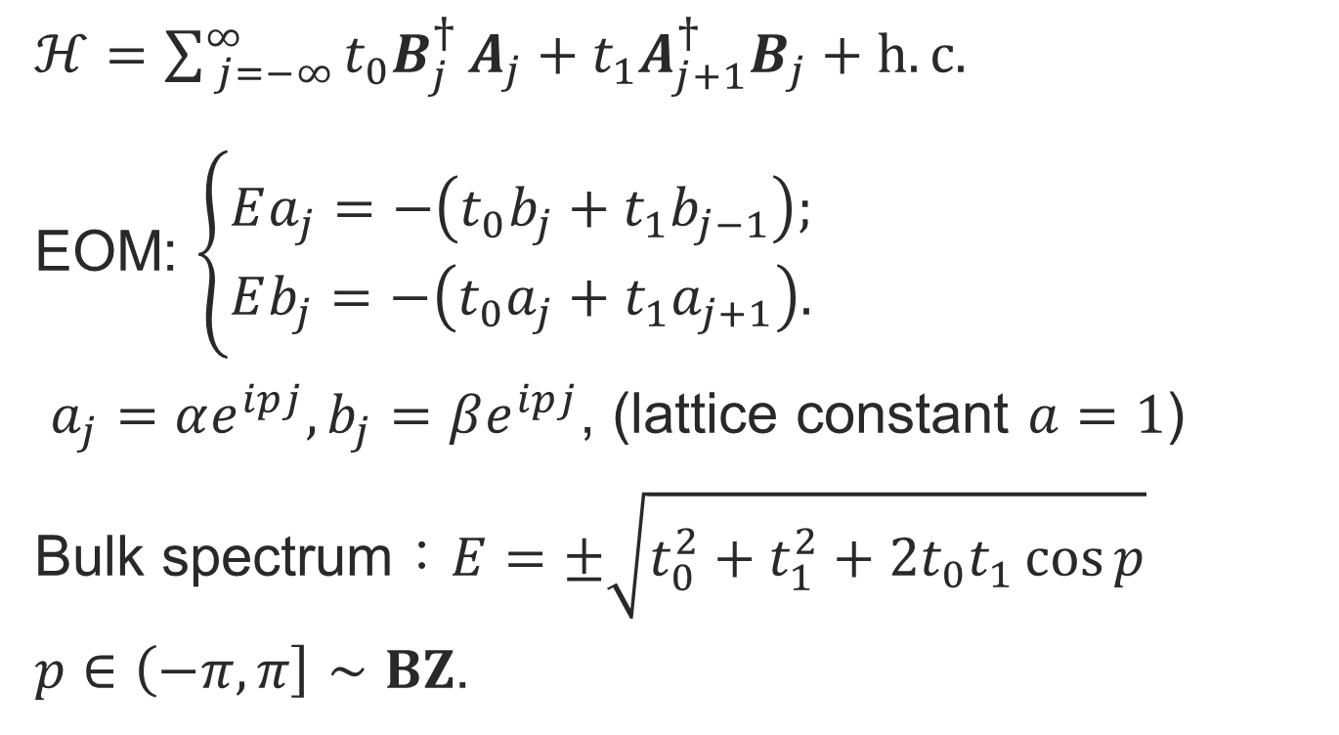
SSH Model I
$ℋ=\sum_{ j=−∞}^{∞}{t_{0}B_{j}^{† }A_{j}+t_{1}A_{j+1}^{† }B_{j}}+h.c.$
EOM: $\left\{\begin{matrix}Ea_{j}=−\left(t_{0}b_{j}+t_{1}b_{j−1}\right); \\ Eb_{j}=−\left(t_{0}a_{j}+t_{1}a_{j+1}\right).\end{matrix}\right.$
$a_{j}=αe^{ipj},b_{j}=βe^{ipj}\text{,}$ (lattice constant $a=1$)
Bulk spectrum：$E=±\sqrt{t_{0}^{2}+t_{1}^{2}+2t_{0}t_{1}\cos{p}}$
$p∈\left(\left.−π, π\right]\right.∼BZ$.

Slide 28
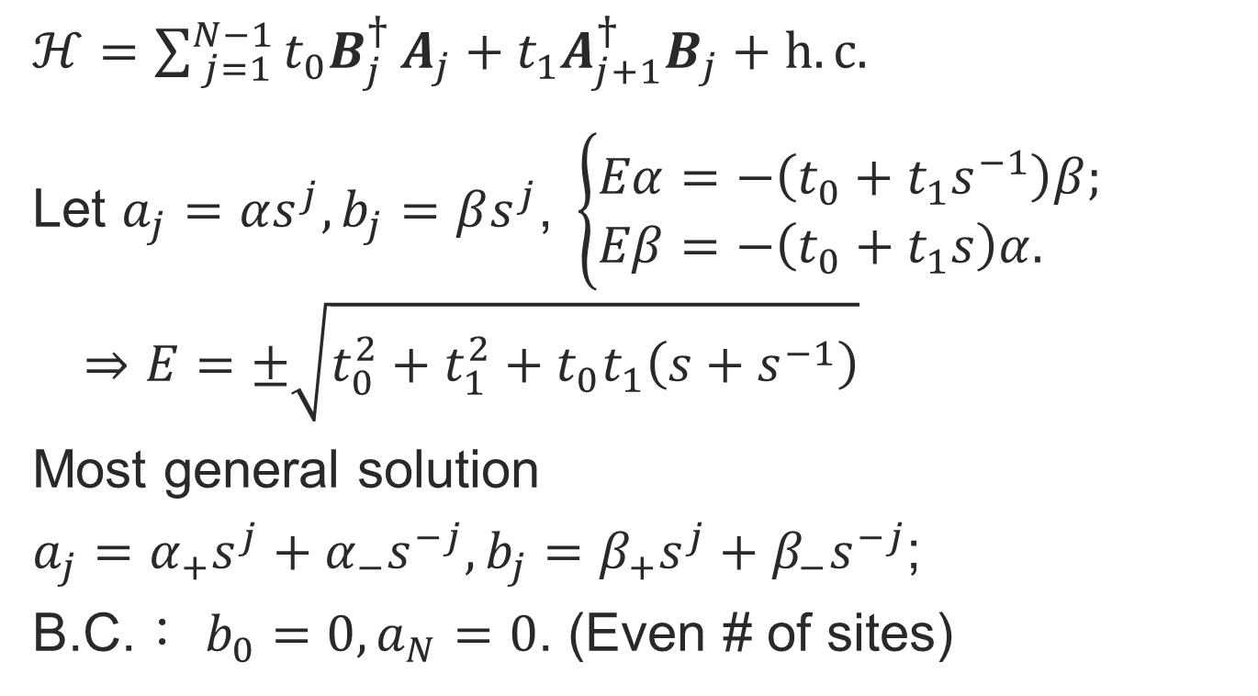
SSH Model II
$ℋ=\sum_{ j=1}^{N−1}{t_{0}B_{j}^{† }A_{j}+t_{1}A_{j+1}^{† }B_{j}}+h.c.$
Let $a_{j}=αs^{j},b_{j}=βs^{j}\text{,} \left\{\begin{matrix}Eα=−\left(t_{0}+t_{1}s^{−1}\right)β; \\ Eβ=−\left(t_{0}+t_{1}s\right)α. \end{matrix}\right.$
$$⇒E=±\sqrt{t_{0}^{2}+t_{1}^{2}+t_{0}t_{1}\left(s+s^{−1}\right)}$$
Most general solution
$a_{j}=α_{+}s^{j}+α_{−}s^{−j},b_{j}=β_{+}s^{j}+β_{−}s^{−j}$;
B.C.： $b_{0}=0, a_{N}=0$. (Even # of sites)

Slide 29
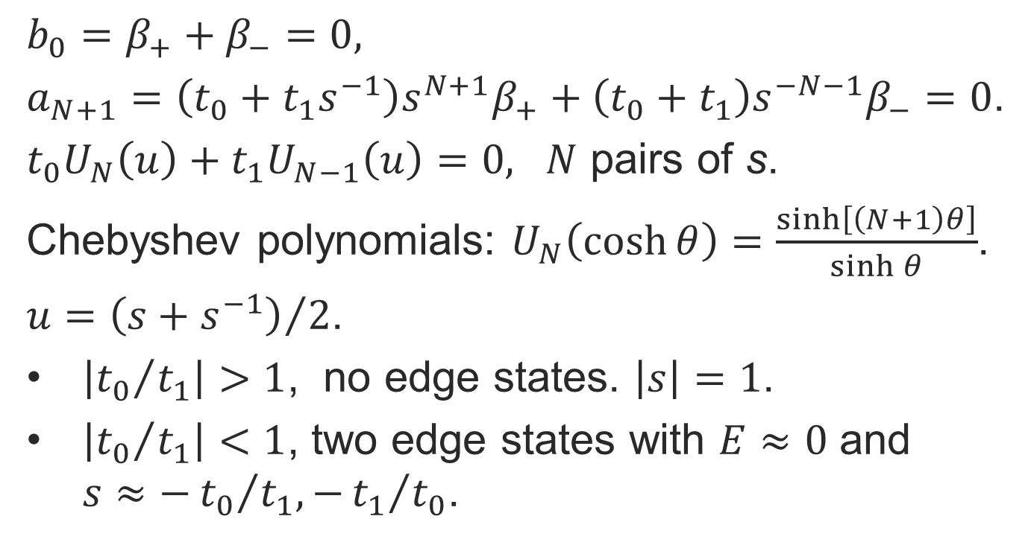
SSH Model III
$b_{0}=β_{+}+β_{−}=0,$
$a_{N+1}=\left(t_{0}+t_{1}s^{−1}\right)s^{N+1}β_{+}+\left(t_{0}+t_{1}\right)s^{−N−1}β_{−}=0$.
$t_{0}U_{N}\left(u\right)+t_{1}U_{N−1}\left(u\right)=0, N$ pairs of s.
Chebyshev polynomials: $U_{N}\left(\cosh{θ}\right)=\frac{\sinh\left[\left(N+1\right)θ\right]}{\sinh{θ}}$.
$u={\left(s+s^{−1}\right)}/2$.
$\left|{t_{0}}/{t_{1}}\right|>1$, no edge states. $\left|s\right|=1$.
$\left|{t_{0}}/{t_{1}}\right|<1$, two edge states with $E≈0$ and $s≈−{t_{0}}/{t_{1}, −{t_{1}}/{t_{0}}}$.

Slide 30
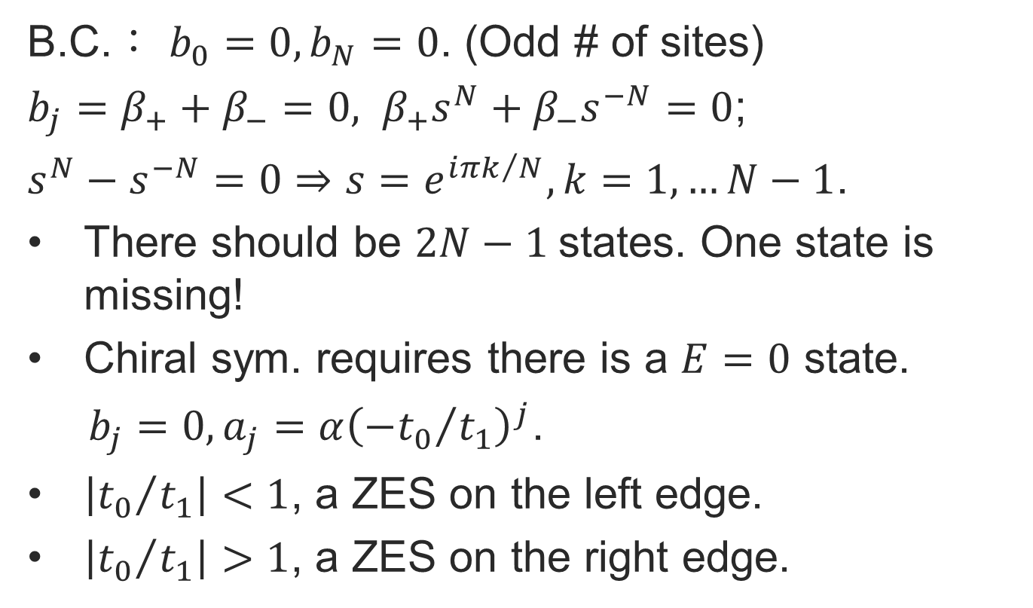
SSH Model IV
B.C.： $b_{0}=0, b_{N}=0$. (Odd # of sites)
$b_{j}=β_{+}+β_{−}=0, β_{+}s^{N}+β_{−}s^{−N}=0$;
$s^{N}−s^{−N}=0⇒s=e^{i{πk}/N}, k=1,…N−1$.
There should be $2N−1$states. One state is missing!
Chiral sym. requires there is a $E=0$ state.
$b_{j}=0, a_{j}=α{\left({−t_{0}}/{t_{1}}\right)}^{j}$.
$\left|{t_{0}}/{t_{1}}\right|<1$, a ZES on the left edge.
$\left|{t_{0}}/{t_{1}}\right|>1$, a ZES on the right edge.

Slide 31
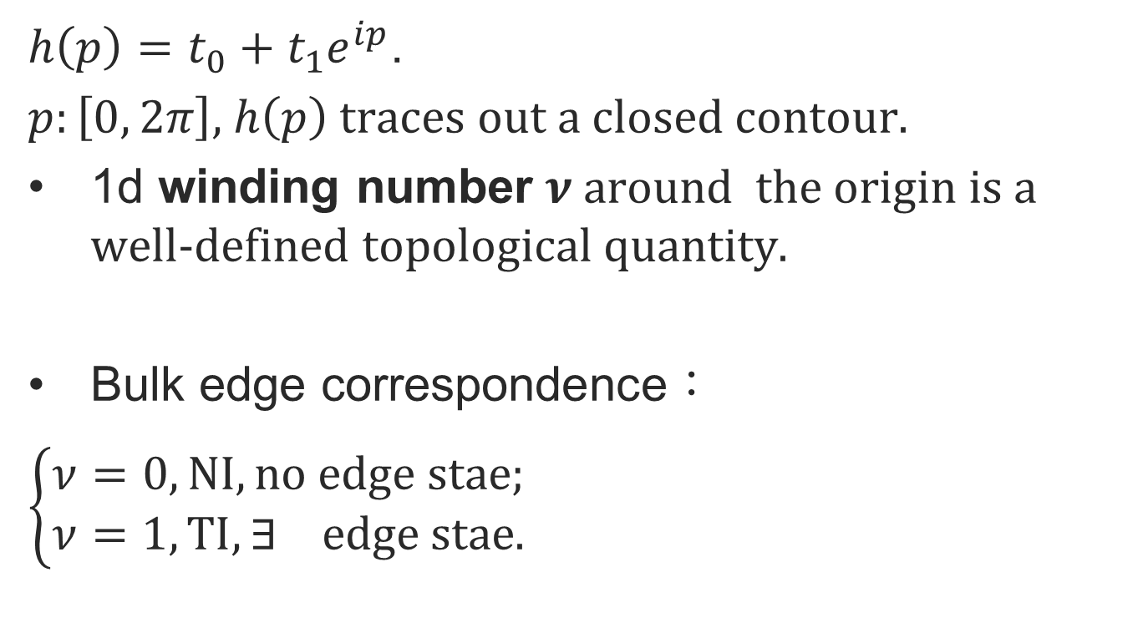
SSH Model V
${h\left(p\right)=t}_{0}+t_{1}e^{ip}$.
$p:\left[0, 2π\right]$, $h\left(p\right)$ traces out a closed contour.
1d winding number $ν$ around the origin is a well-defined topological quantity.
Bulk edge correspondence：
$\left\{\begin{matrix}ν=0, NI, no edge stae; \\ ν=1, TI, ∃ edge stae.\end{matrix}\right.$

Slide 32
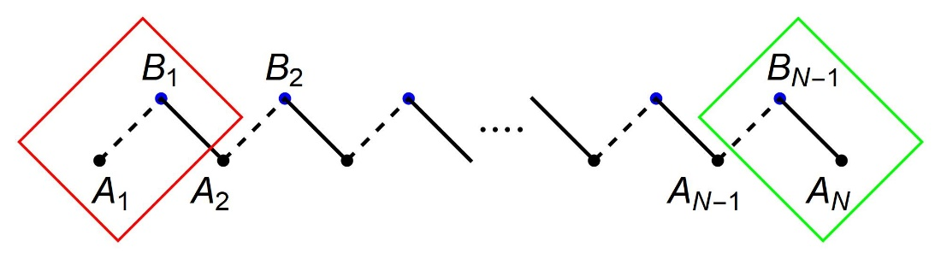
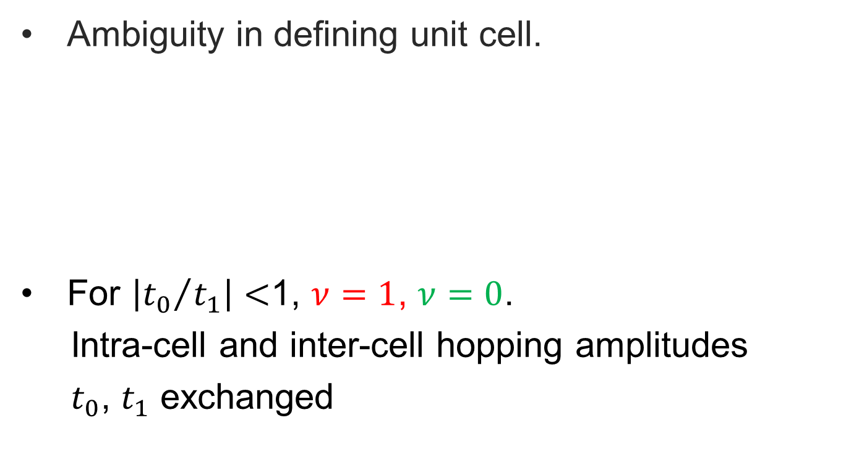
SSH Model VI
Ambiguity in defining unit cell.
For $\left|{t_{0}}/{t_{1}}\right|<$1, $ν=1$, $ν=0$.
Intra-cell and inter-cell hopping amplitudes
$t_{0}$, $t_{1}$ exchanged

Slide 33
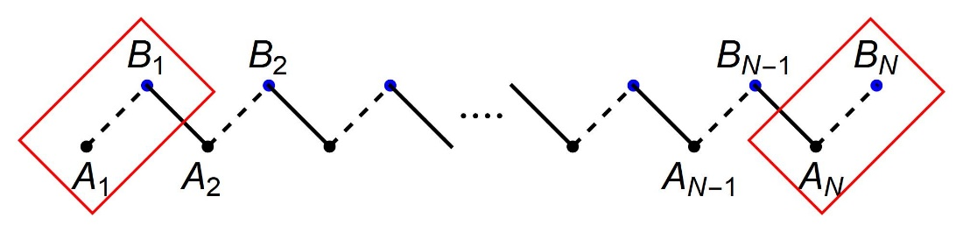

SSH Model VII
$\text{For} \text{even}\text{ \# }\text{of} \text{sites}\text{: }\text{same} \text{choice}\text{;}$
$\left|{t_{0}}/{t_{1}}\right|>1$, no edge states. $\left|s\right|=1$.
$\left|{t_{0}}/{t_{1}}\right|<1$, two edge states with $E≈0$ and $s≈−{t_{0}}/{t_{1}, −{t_{1}}/{t_{0}}}$.

Slide 34

SSH Model VIII
$\text{For} \text{odd}\text{ \# }\text{of} \text{sites}:\text{opposite} \text{choice}.$
$\left|{t_{0}}/{t_{1}}\right|<1$, a ZES on the left edge.
$\left|{t_{0}}/{t_{1}}\right|>1$, a ZES on the right edge.

Slide 35
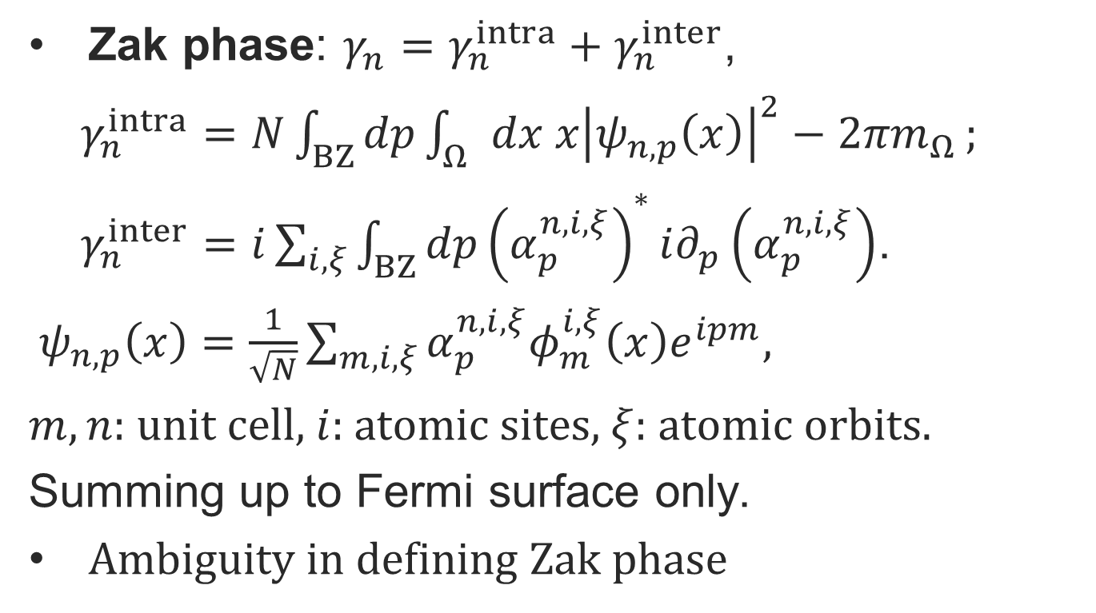
SSH Model IX
Zak phase: $γ_{n}=γ_{n}^{intra}+γ_{n}^{inter}$,
$γ_{n}^{intra}=N\int_{BZ}{dp}\int_{Ω}{dx x{\left|ψ_{n,p}\left(x\right)\right|}^{2}−{2πm}_{Ω}};$
$γ_{n}^{inter}=i\sum_{i, ξ}{\int_{BZ}{dp}{\left(α_{p}^{n,i,ξ}\right)}^{∗}i∂_{p}\left(α_{p}^{n,i,ξ}\right)}$.
$ψ_{n,p}\left(x\right)=\frac{1}{\sqrt{N}}\sum_{m, i, ξ}{α_{p}^{n,i,ξ}φ_{m}^{i,ξ}\left(x\right)e^{ipm}}$,
$m,n:$ unit cell, $i$: atomic sites, $ξ$: atomic orbits.
Summing up to Fermi surface only.
Ambiguity in defining Zak phase

Slide 36
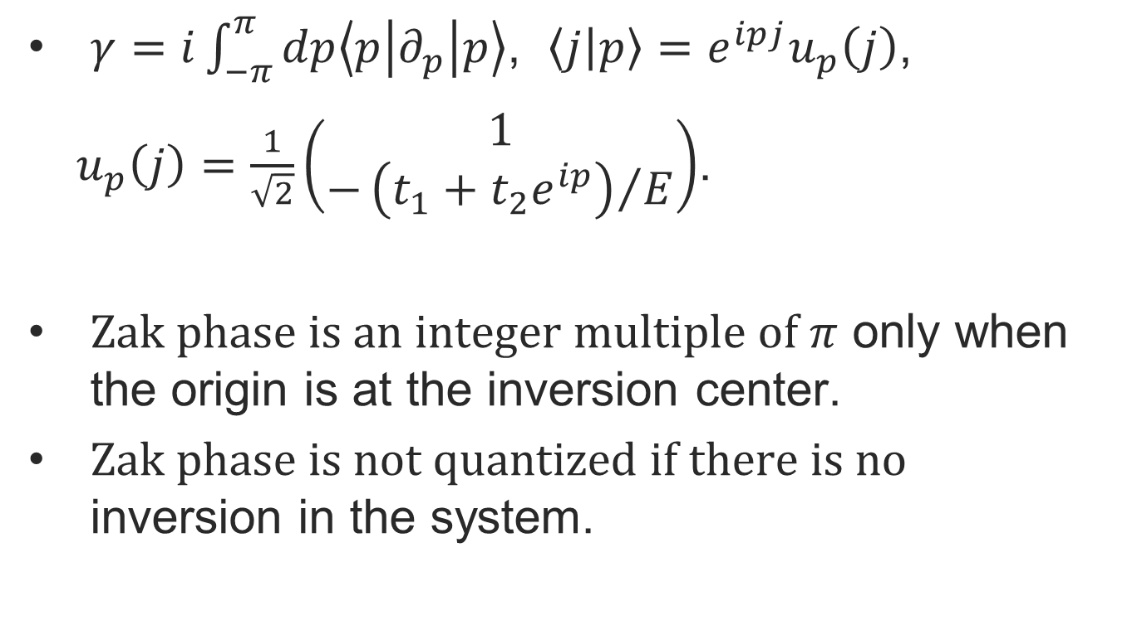
SSH Model X
$γ=i\int_{−π}^{π}{dp\left\langle p | ∂_{p} | p\right\rangle }$, $\left\langle j | p\right\rangle =e^{ipj}u_{p}\left(j\right)$,
$u_{p}\left(j\right)=\frac{1}{\sqrt{2}}\left(\begin{matrix}1 \\ −{\left(t_{1}+t_{2}e^{ip}\right)}/E\end{matrix}\right)$.
Zak phase is an integer multiple of $π$ only when the origin is at the inversion center.
Zak phase is not quantized if there is no inversion in the system.

Slide 37
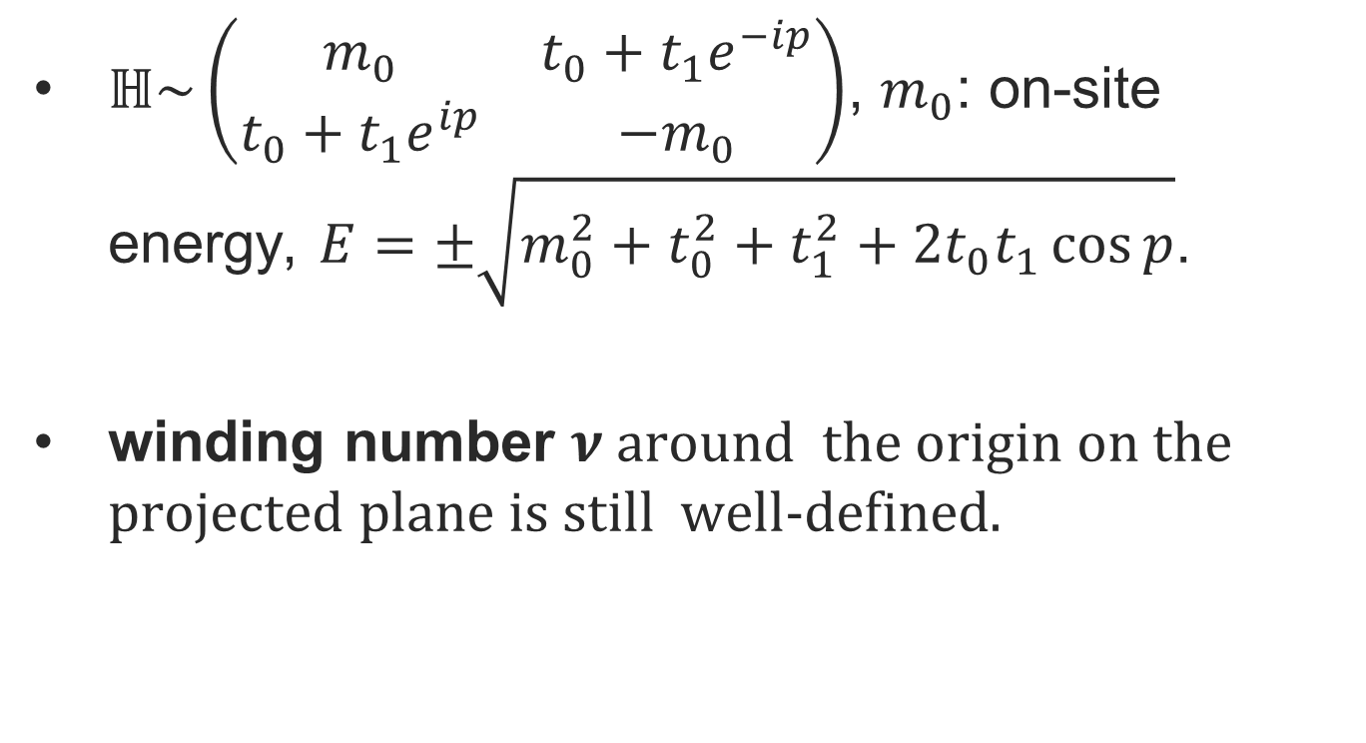
Generalization of the Zak phase I
$ℍ\sim \left(\begin{matrix}m_{0} & t_{0}+t_{1}e^{−ip} \\ t_{0}+t_{1}e^{ip} & −m_{0}\end{matrix}\right)$, $m_{0}$: on-site energy, $E=±\sqrt{m_{0}^{2}+t_{0}^{2}+t_{1}^{2}+2t_{0}t_{1}\cos{p}}$.
winding number $ν$ around the origin on the projected plane is still well-defined.

Slide 38
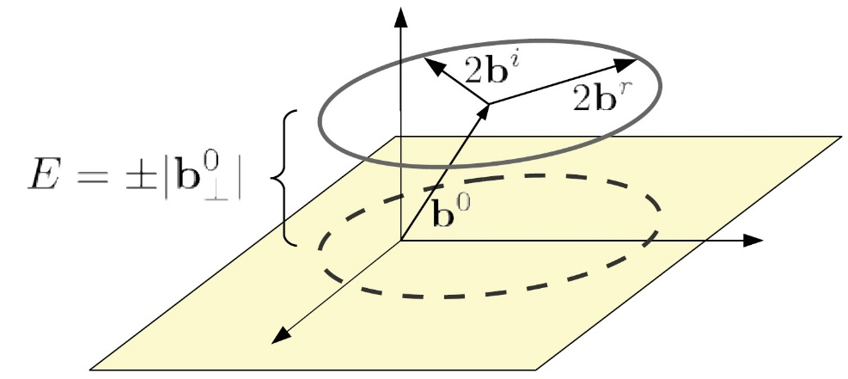

Generalization of the Zak phase II
Mong PRB 88 (2011)
Generalization of the Zak phase:
$γ=i\int_{−π}^{π}{dp\left(\left\langle p,+ | ∂_{p} | p,+\right\rangle +\left\langle p,− | ∂_{p} | p,−\right\rangle \right)}$
$=\int_{−π}^{π}{dp\left({h′}/h\right)=2πν}$.
If we sum over the two bands, the 2d Chern # would just give zero!

Slide 39

Generalization of the Zak phase III
Let $a_{j}=αs^{j},b_{j}=βs^{j}\text{,} \left\{\begin{matrix}\left(E−m_{0}\right)α=−\left(t_{0}+t_{1}s^{−1}\right)β; \\ \left(E+m_{0}\right)β=−\left(t_{0}+t_{1}s\right)α. \end{matrix}\right.$
$$⇒E=±\sqrt{m_{0}^{2}+t_{0}^{2}+t_{1}^{2}+t_{0}t_{1}\left(s+s^{−1}\right)}$$
Most general solution
$a_{j}=α_{+}s^{j}+α_{−}s^{−j},b_{j}=β_{+}s^{j}+β_{−}s^{−j}$;

Slide 40

Generalization of the Zak phase IV
Most general solution
$a_{j}=α_{+}s^{j}+α_{−}s^{−j},b_{j}=β_{+}s^{j}+β_{−}s^{−j}$;
B.C.： $b_{0}=0, b_{N}=0$. (Odd # of sites)
$b_{j}=β_{+}+β_{−}=0, β_{+}s^{N}+β_{−}s^{−N}=0$;
$s^{N}−s^{−N}=0⇒s=e^{i{πk}/N}, k=1,…N−1$.
Edge state: $β=0$,
$\left(E−m_{0}\right)α=0$, $−\left(t_{0}+t_{1}s\right)α=0$.

Slide 41


Generalization of the Zak phase V

Slide 42
Generalization of the Zak phase VI
[Schnyder et al. (2008)]; [Kitaev (2009)].
$Θ$ : time reversal, $Ξ$: particle hole, $Π$: chiral
Classification of the symmetric space of Lie algebra

Slide 43

Conclusion I
$γ=\sum_{n=±}{i\int_{−π}^{π}{dp\left\langle p,n | ∂_{p} | p,n\right\rangle }}$
$=\int_{−π}^{π}{dp\left({h′}/h\right)=2πν}$, $ν$: winding #.
$\left|{t_{0}}/{t_{1}}\right|>1$, $ν=0$, no edge states.
$\left|{t_{0}}/{t_{1}}\right|<1$, $ν=1$, $∃$ edge states with $E≈0$ and $s≈−{t_{0}}/{t_{1}, −{t_{1}}/{t_{0}}}$.

Slide 44

Conclusion II
In carbon nanotube zigzag edge is equivalent to an SSH model.
$ℋ=\sum_{ j_{y}=1}^{N_{y}}{t_{0}B_{j_{y}}^{† }\left(p_{x}\right)A_{j_{y}}\left(p_{x}\right)+t_{1}A_{j_{y}+1}^{† }\left(p_{x}\right)B_{j_{y}}\left(p_{x}\right)}$
$+h.c.$
$t_{0}=2t\cos\left({p_{x}a}/2\right)$, $t_{1}=t$,
$p_{x}={\left(2πk_{x}\right)}/{\left(N_{x}a\right)}$, $k_{x}=1, …, N_{x}$.
Dirac (Weyl) points: $p_{x}=π/{\left(3a\right),}{2π}/{\left(3a\right)}$.
Fermi arc.

Slide 45

Conclusion III
Zigzag-zigzag edge even # sites.
Zigzag-zigzag beard edge odd # sites.
Wang, NJP 18, (2016)

Slide 46

Conclusion IV
Armchair-armchair edge non-topological.
Armchair- armchair beard edge topological.
Wang, NJP 18, (2016)

Slide 47

Conclusion V
$γ=\int_{−π}^{π}{dp\left({h′}/h\right)=2πν}$,
$h=t_{0}+t_{1}e^{ip}+t_{2}e^{i2p}+…t_{n}e^{inp}$.
Consider the trimmer case of polyacetylene $ℍ\sim \left(\begin{matrix}0 & t_{0} & t_{1}e^{−ip} \\ t_{0} & 0 & t_{0} \\ t_{1}e^{ip} & t_{0} & 0\end{matrix}\right)$
$γ=\sum_{n=1}^{3}{i\int_{−π}^{π}{dp\left\langle p,n | ∂_{p} | p,n\right\rangle }}=\text{2}πν$, $ν∈ℤ$.

